Slide 1
Service-oriented Software Engineering (SoSE)
Describing REST WS with Open API and Swagger
Prof. Marco Autili
University of L’Aquila
marco.autili@univaq.it
http://people.disim.univaq.it/marco.autili/

Slide 2

What have we done? (from previous lectures)
When a service has a complex interface and is not a simple resource, it can be (more w.r.t. SOAP Services) difficult to design a set of RESTful services to represent it
There are no standards for RESTful interface description so service users must rely on informal documentation to understand the interface
WADL (https://it.wikipedia.org/wiki/Web_Application_Description_Language)
OpenAPI Specification (also kwon as Swagger Specification - https://it.wikipedia.org/wiki/Specifiche_OpenAPI)

Slide 3
What is Swagger?
It is for simplifying the design, development and documentation of APIs
The power of the Swagger starts with the OpenAPI Specification, formerly known as the Swagger Specification, which is the industry standard for RESTful API design
The specification permits to create a RESTful interface for easily developing and consuming an API by effectively mapping all the resources and operations associated with it
A curiosity the OpenAPI Specification was donated to the Linux Foundation under the OpenAPI Initiative in 2015
We will see how to conveniently exploit Swagger to
document REST services
get a ready-to-use client web application that permit you to interact with REST services directly from a browser
Automatically generate a client application to junit test REST services

Slide 4
Ingredients
Java SE Development Kit 8
https://www.oracle.com/technetwork/java/javase/downloads/jdk8-downloads.html
Eclipse IDE for Enterprise Java Developers
https://www.eclipse.org/downloads/packages
Apache Tomcat® (v.8.5.58) [core - zip or tar.gz]
https://tomcat.apache.org/download-80.cgi
Apache CXFTM (v.3.3.7) [binary distribution - zip or tar.gz]
http://cxf.apache.org/download.html
Apache Maven (v.3.6.3)
https://maven.apache.org/download.cgi
Swagger Editor
https://editor.swagger.io/
This year, I’m also using Apache Tomcat 9.0.73
(indeed, version 10.1.7 is now avaiable…)
This year, I’m also using Apache CXF 3.5.5 (indeed, version 4.0.0 is now avaiable…)
This year, I’m also using Apache Maven version 3.8.5 and 3.8.8 (indeed, version 3.9.0 is now avaiable…)

Slide 5
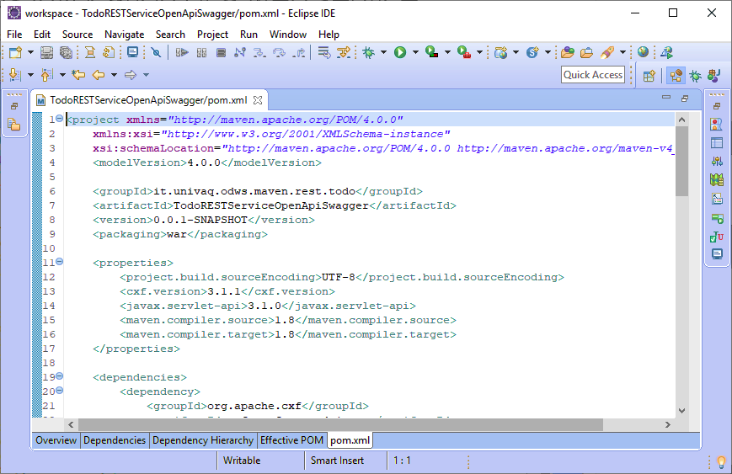
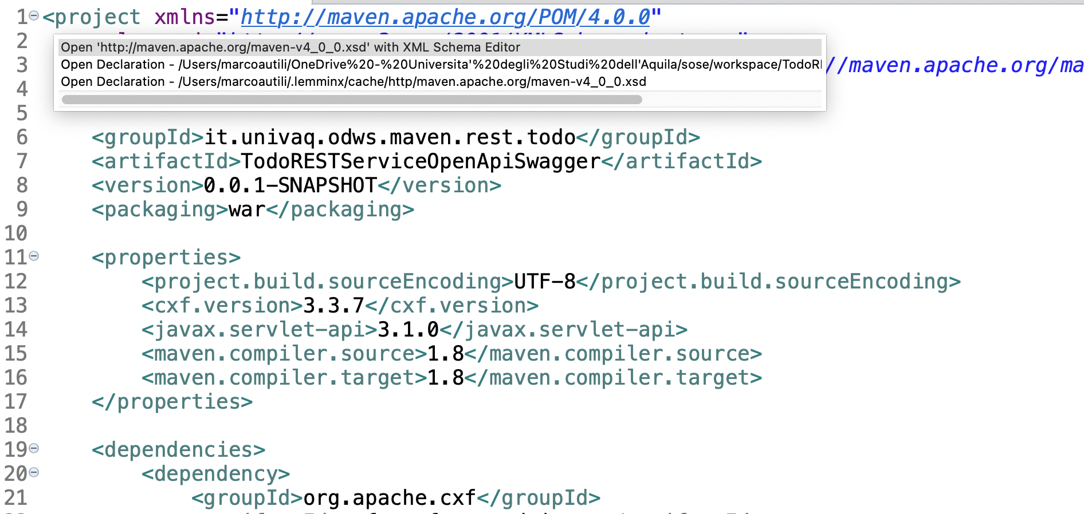
Create TodoRESTServiceOpenApiSwagger
1

Slide 6
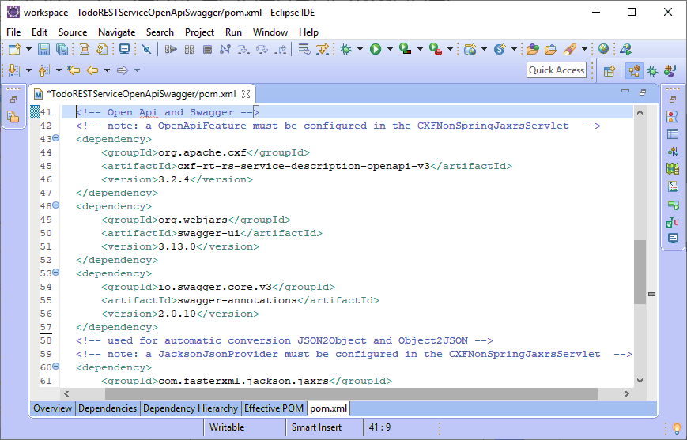
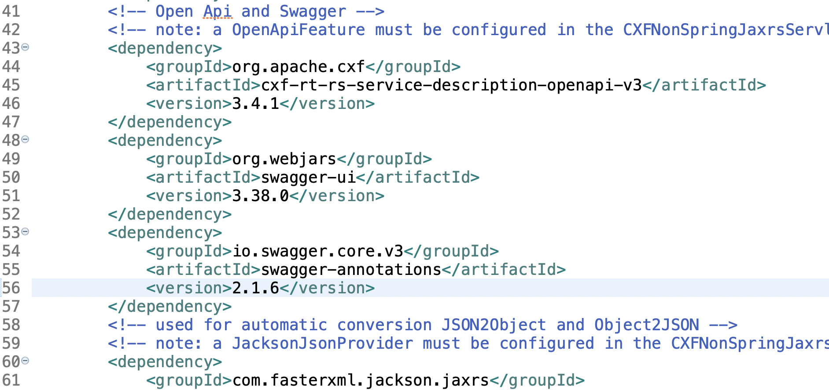
Add Openapi and Swagger dependencies
For generating OpenAPI v3.0 documents from JAX-RS service endpoints
1
For including client-side web libraries (e.g., jQuery & Bootstrap) packaged into JAR
2
Offers annotations to produce Swagger documentation
3

Slide 7
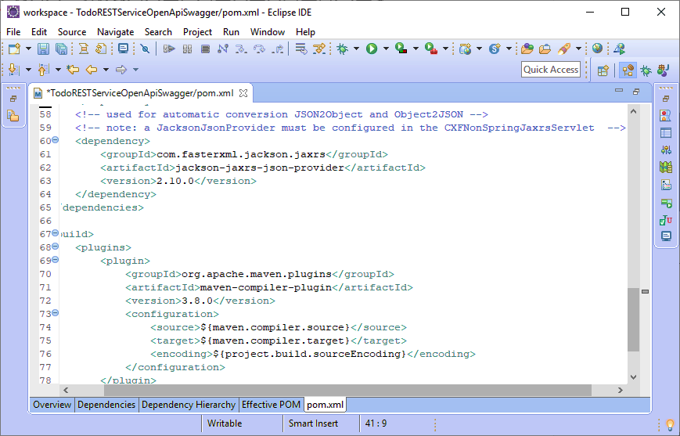
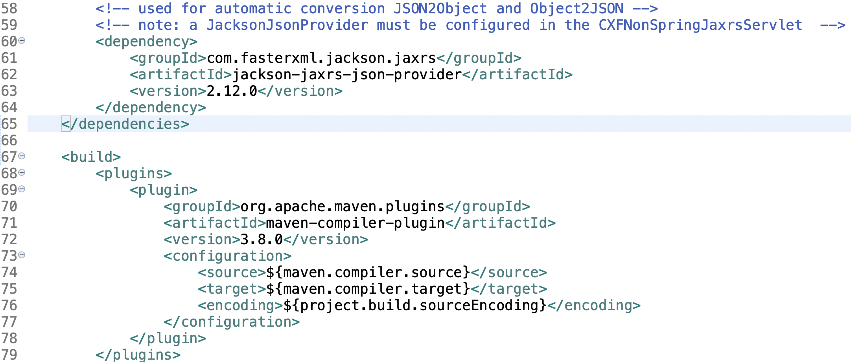
Add jackson-jaxrs-json provider dependency
Automatically serialize and deserialize resources for JSON content MediaType
1
4

Slide 8
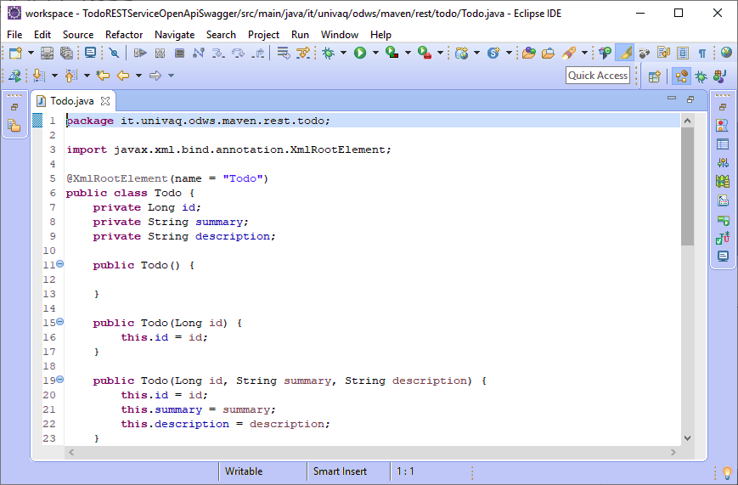
Create the Todo Class
Todo objects are JAXB-supported objects
In next slides, it will be used for the annotation @Schema (implementation = Todo.class)
1
2
3

Slide 9
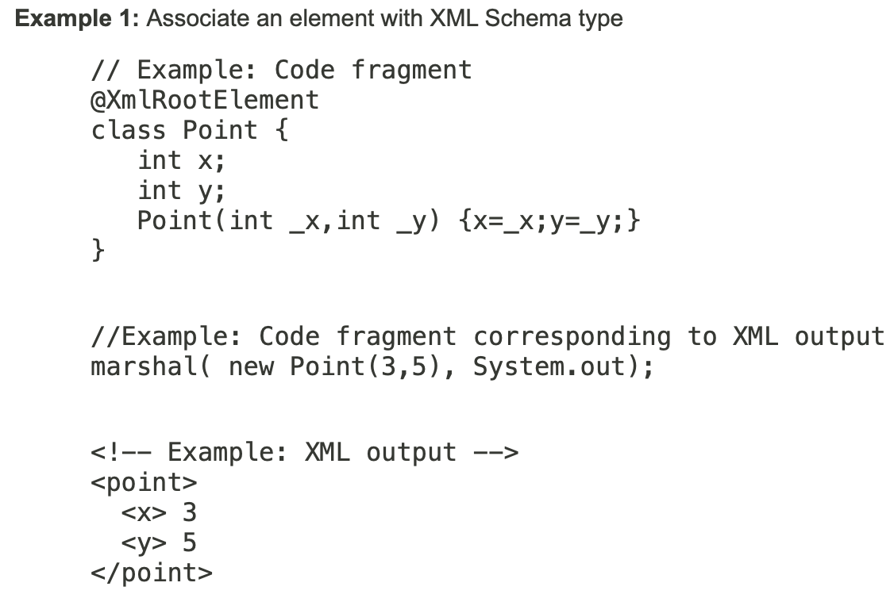
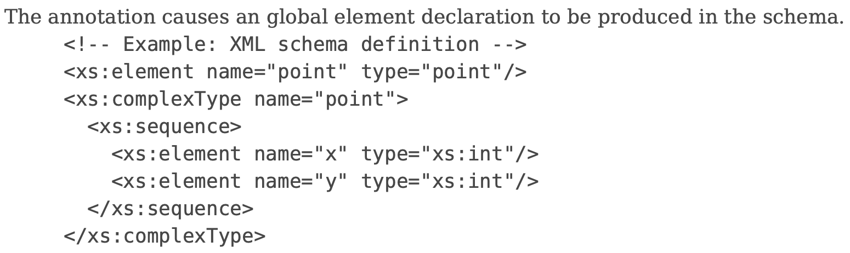
Annotation Type XmlRootElement
https://docs.oracle.com/javase/8/docs/api/javax/xml/bind/annotation/XmlRootElement.html

Slide 10
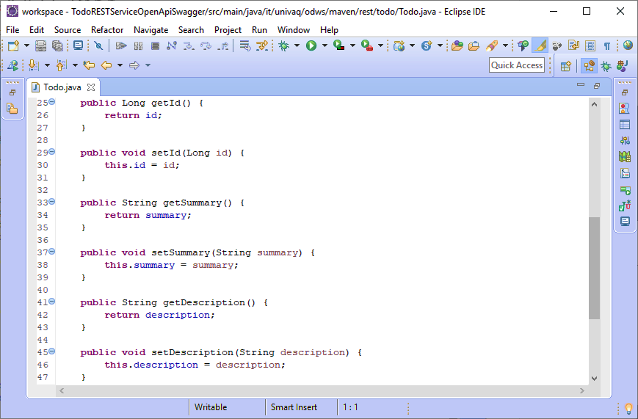
Create the Todo Class
1
2
3
4
5
6

Slide 11
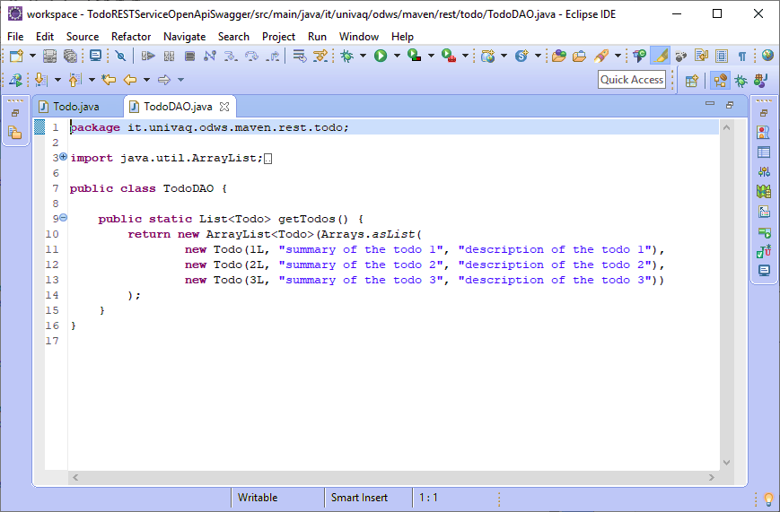
Create the TodoDAO class
1

Slide 12
Just not to forget... ☺
POST is used to create a resource. It has associated data that defines the resource
GET is used to read the value of a resource and return that to the requestor in the specified representation, such as XHTML, that can be rendered in a web browser
PUT is used to update the value of a resource
DELETE is used to delete the resource

Slide 13
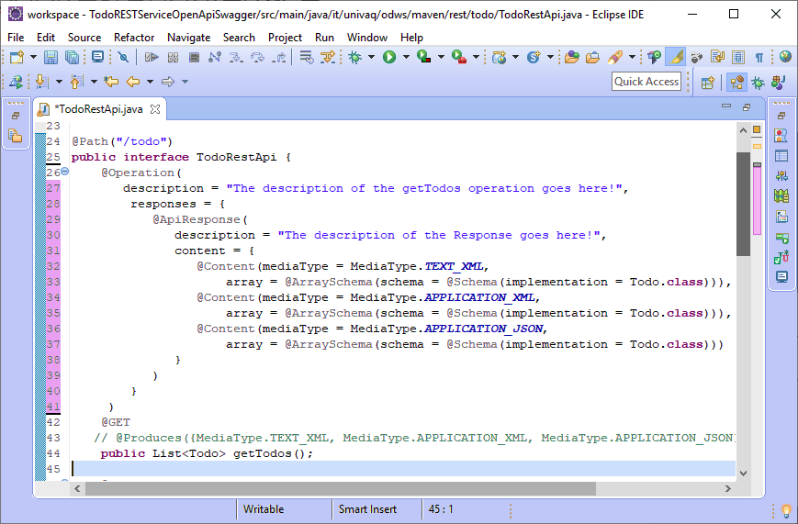

Create the TodoRestApi Interface
text/xml vs application/xml
This is an old question, but from the RFC 7303 recommendations (section 9.2):
“The registration information for text/xml is in all respects the same as that given for application/xml above (Section 9.1), except that the “Type name” is “text”.”
2

Slide 14
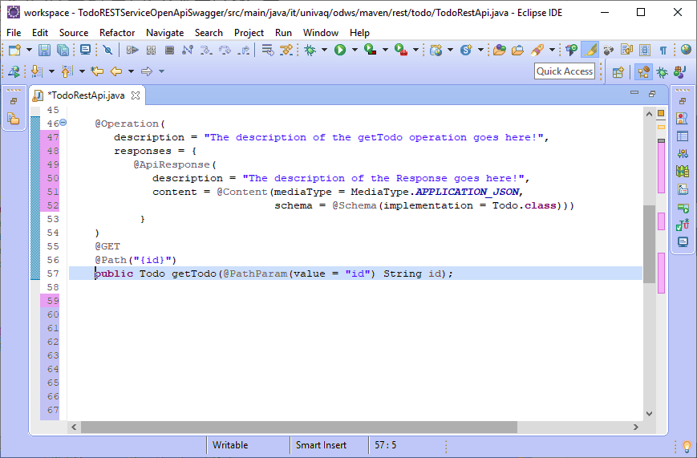
Create the TodoRestApi Interface
1

Slide 15
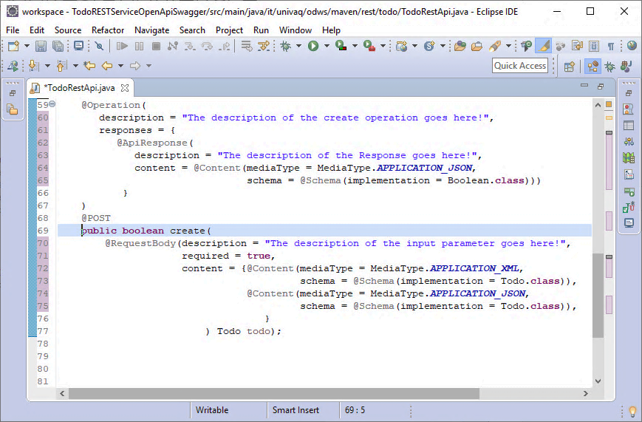
Create the TodoRestApi Interface
1

Slide 16
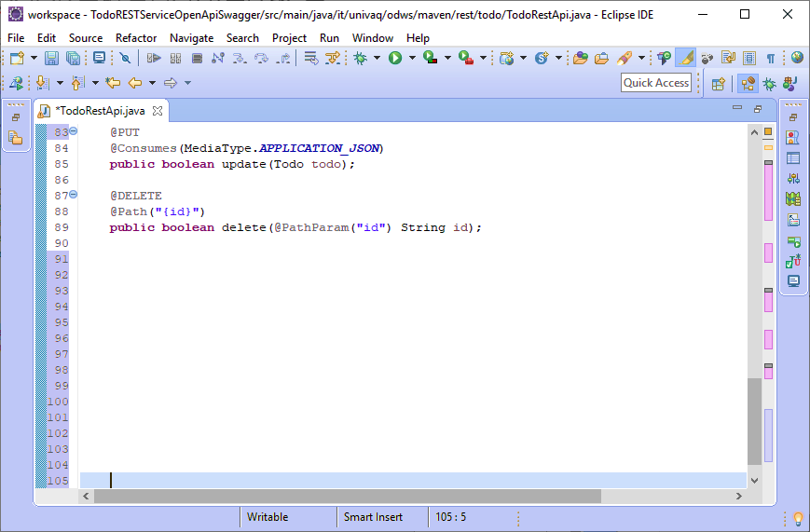
Create the TodoRestApi Interface
See mediaType=application/json for the PUT method within the representaiton tag of the WADL in next slides
1
2

Slide 17
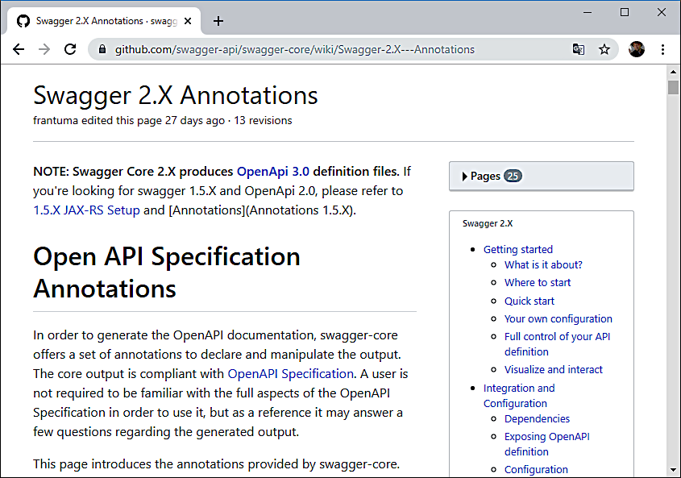
Complete Description of Swagger Annotations
1

Slide 18
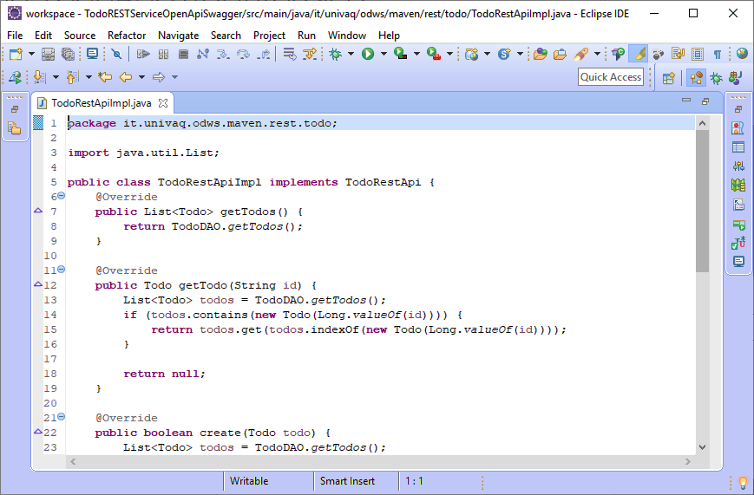
Implement the TodoRestApi Interface
1
2
3

Slide 19
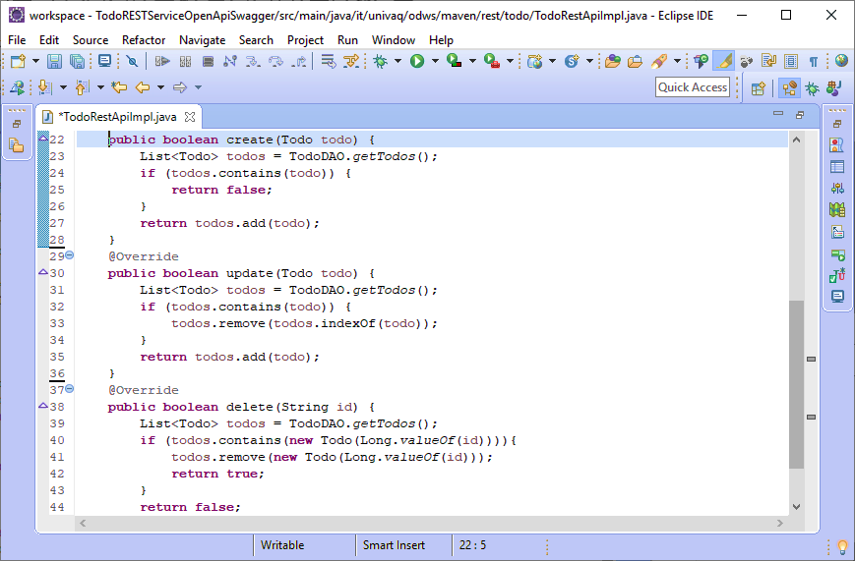
Implement the TodoRestApi Interface
1
2
3

Slide 20
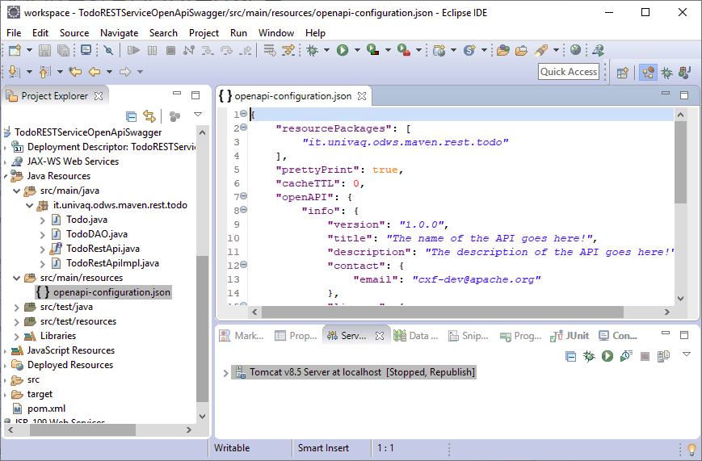
Create the openapi-configuration.json
1
This configuration can also be done programmatically in Java or using Spring
https://cwiki.apache.org/confluence/display/CXF20DOC/OpenApiFeature#OpenApiFeature-ConfiguringinCXFNonSpringJaxrsServlet

Slide 21
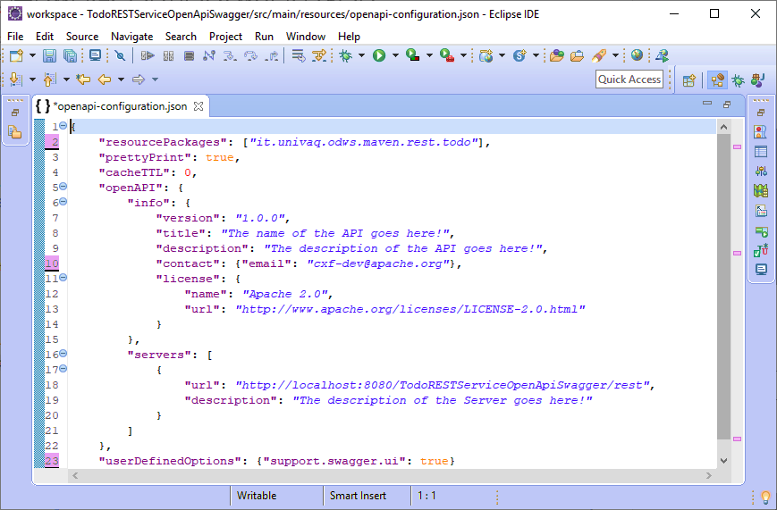
Create the openapi-configuration.json
1
2

Slide 22
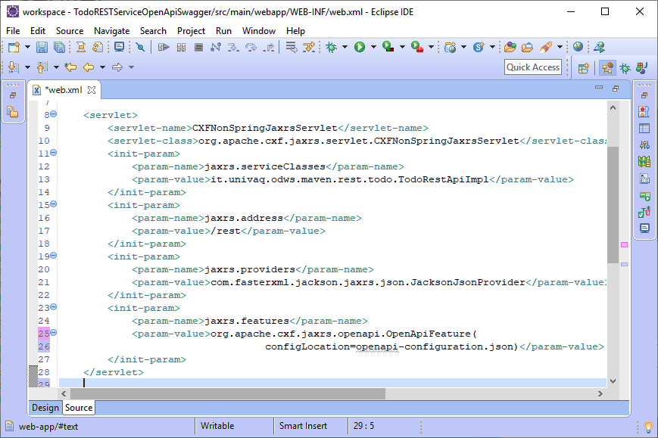
Configure the servlet
1
2

Slide 23
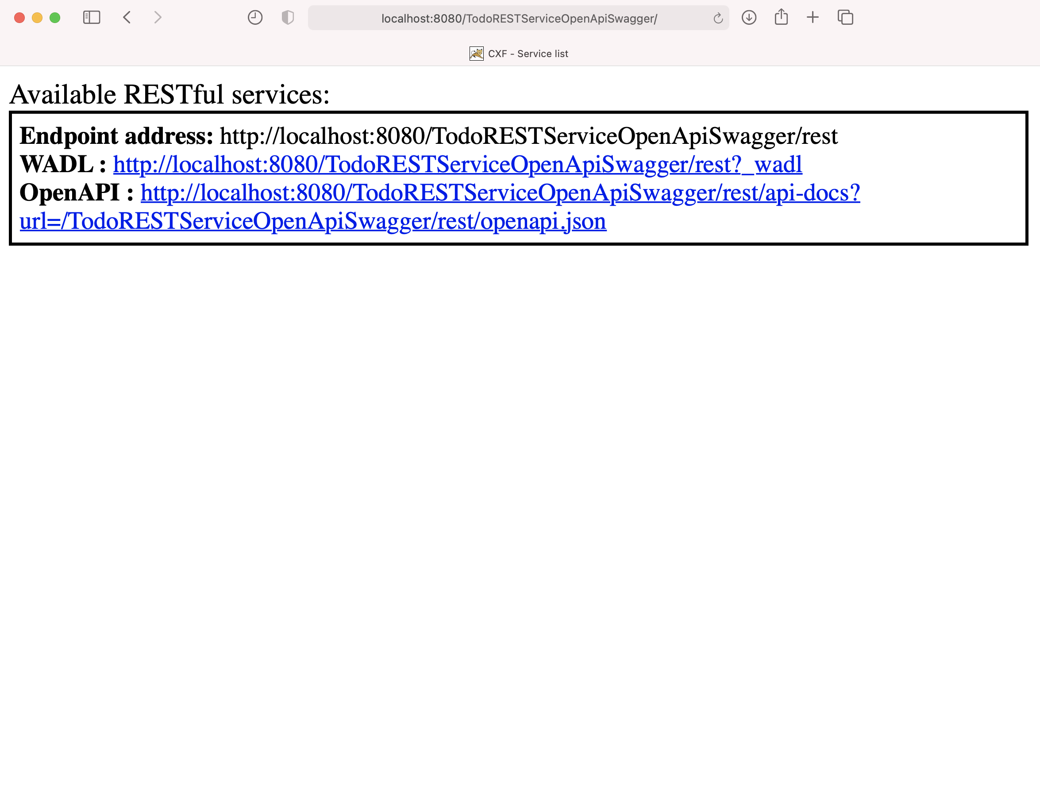
Deploy the REST Service
1

Slide 24
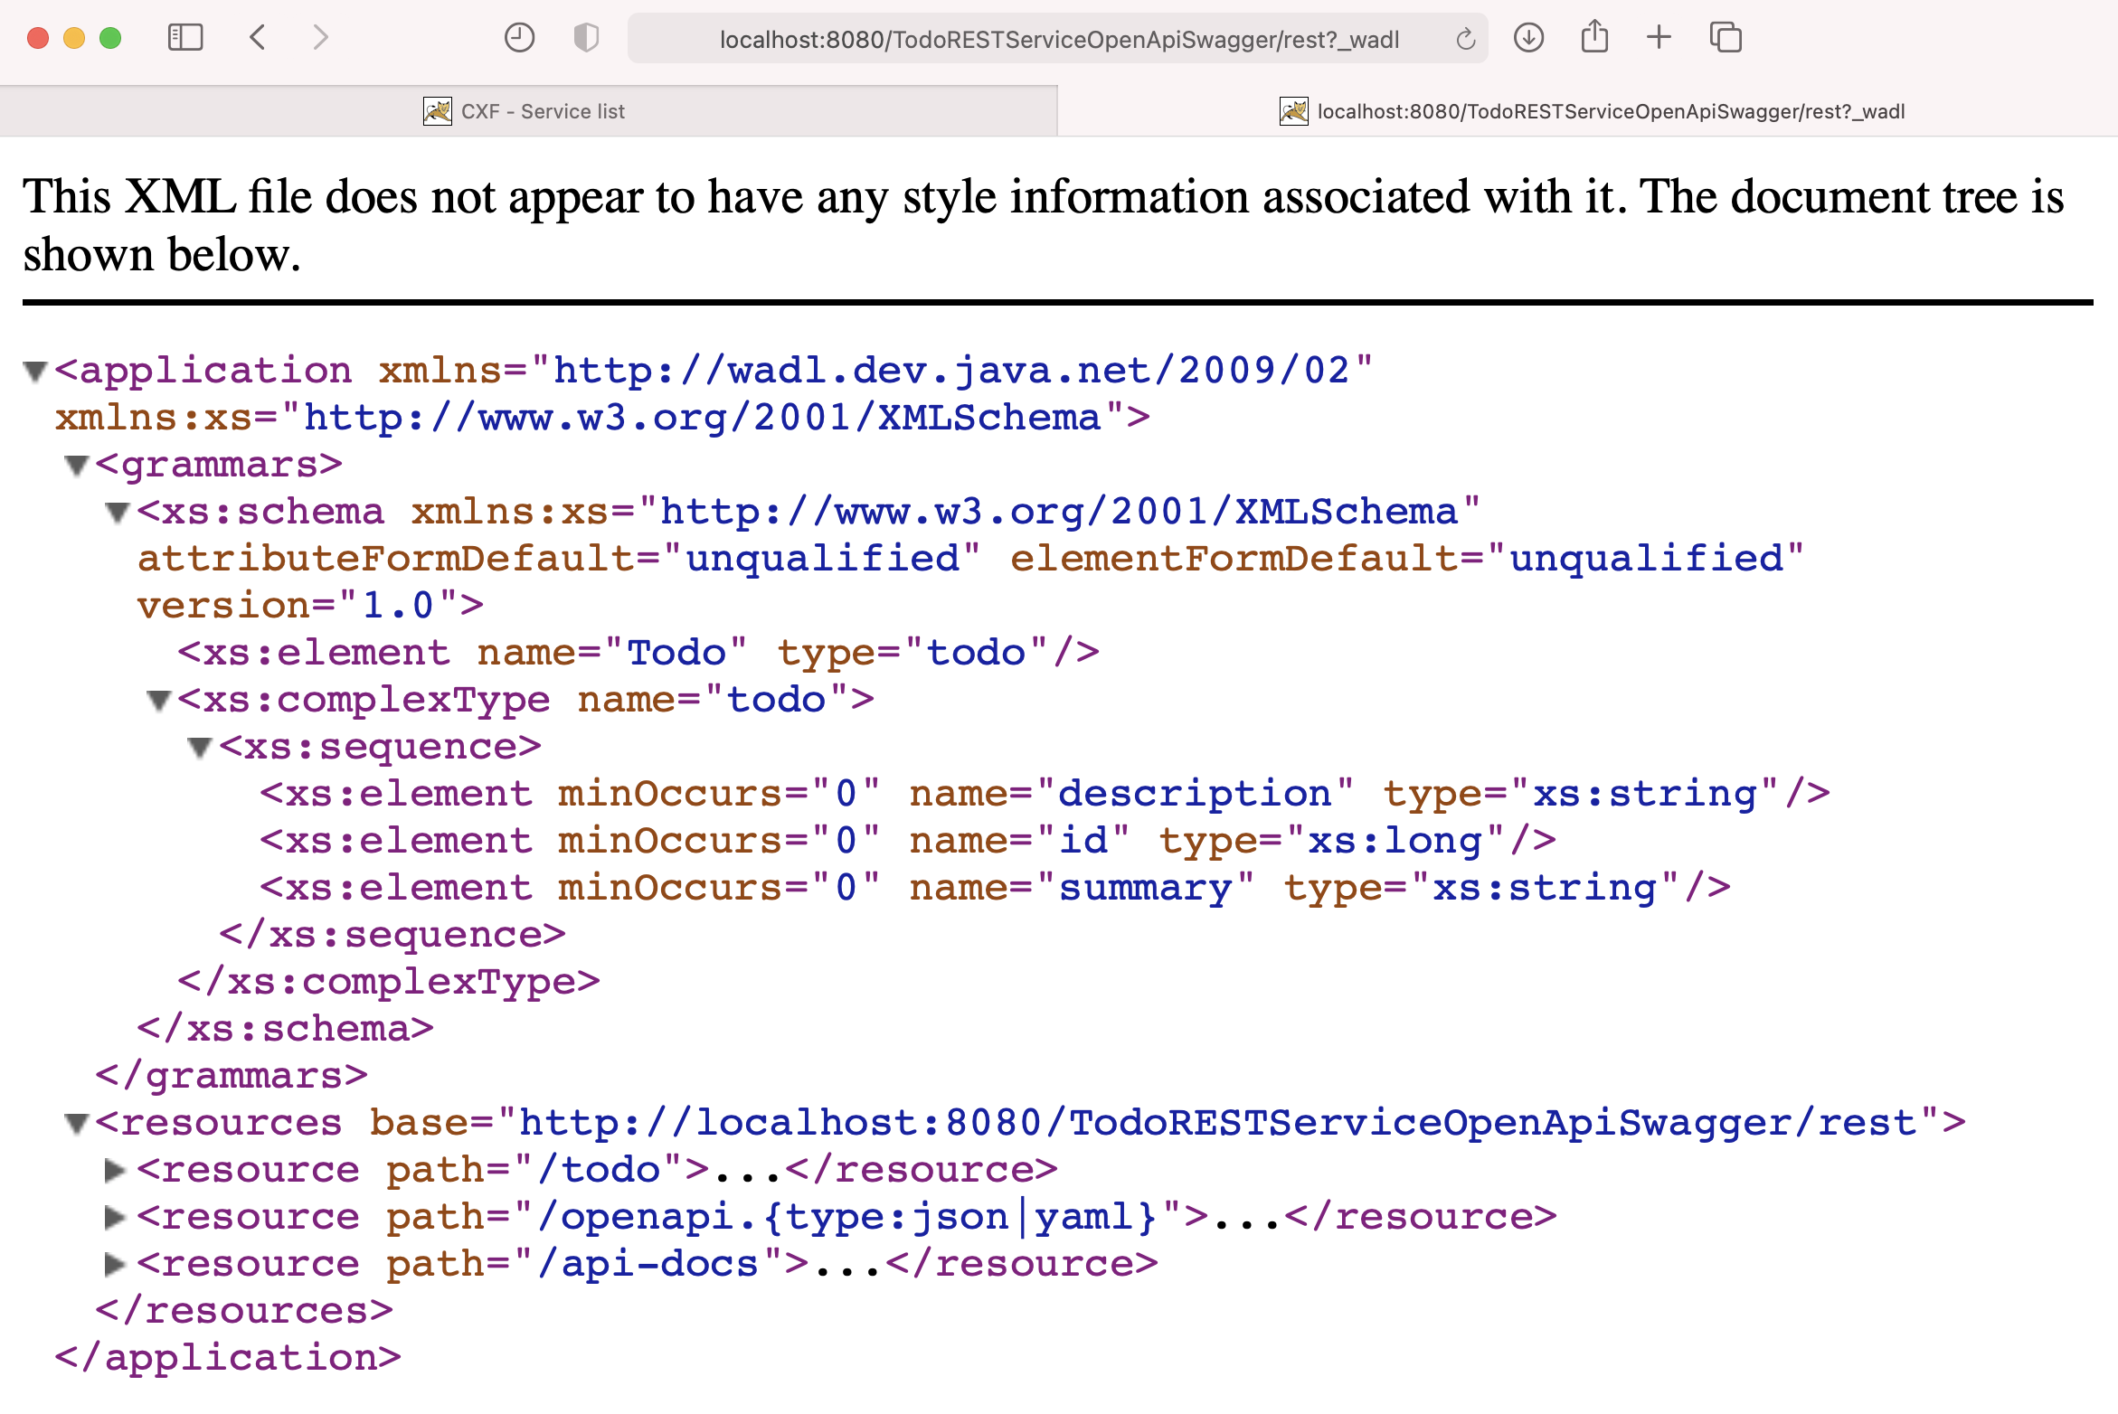
The REST API description - WADL
1
3
2

Slide 25
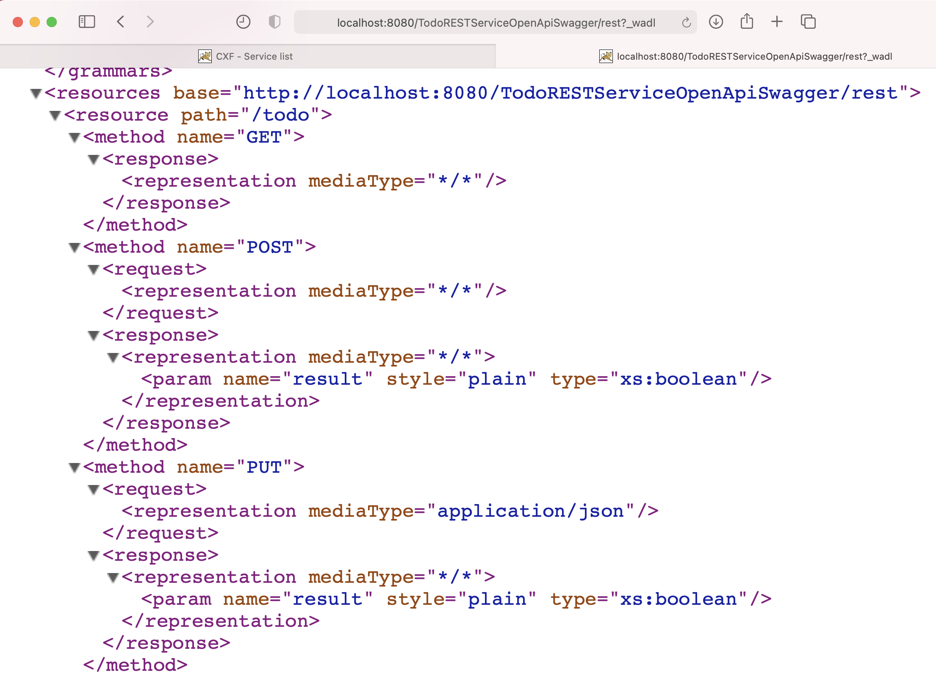
The REST API description - WADL
1.1
1.2
1.3

Slide 26
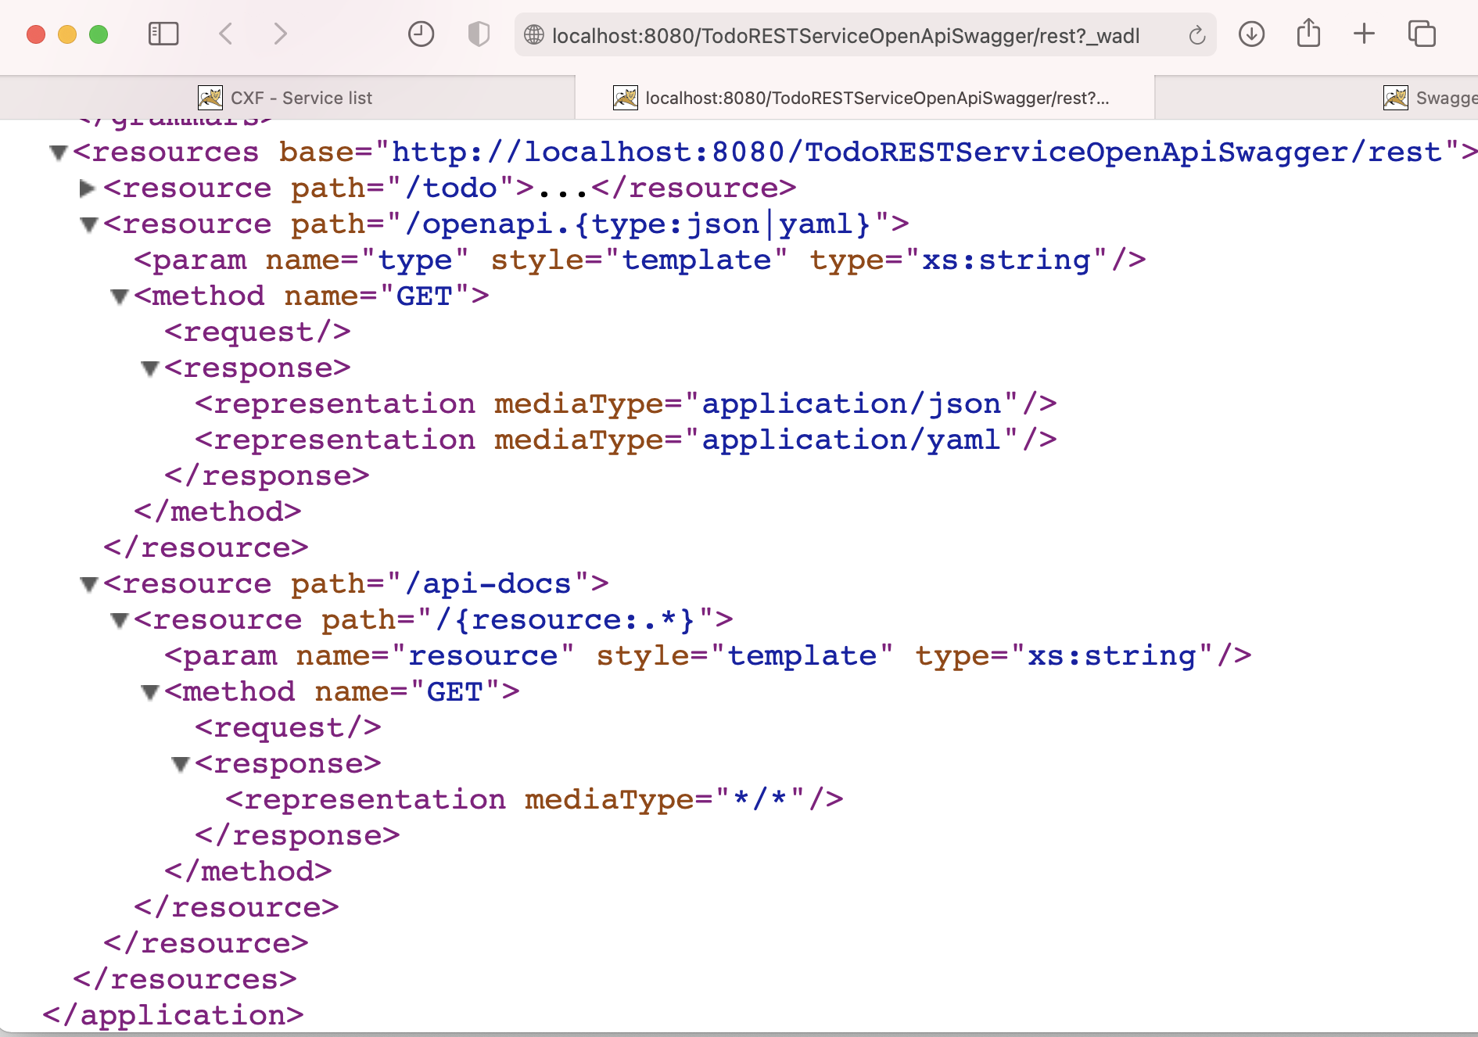
The REST Api description - WADL
2
2.1
3
3.1

Slide 27
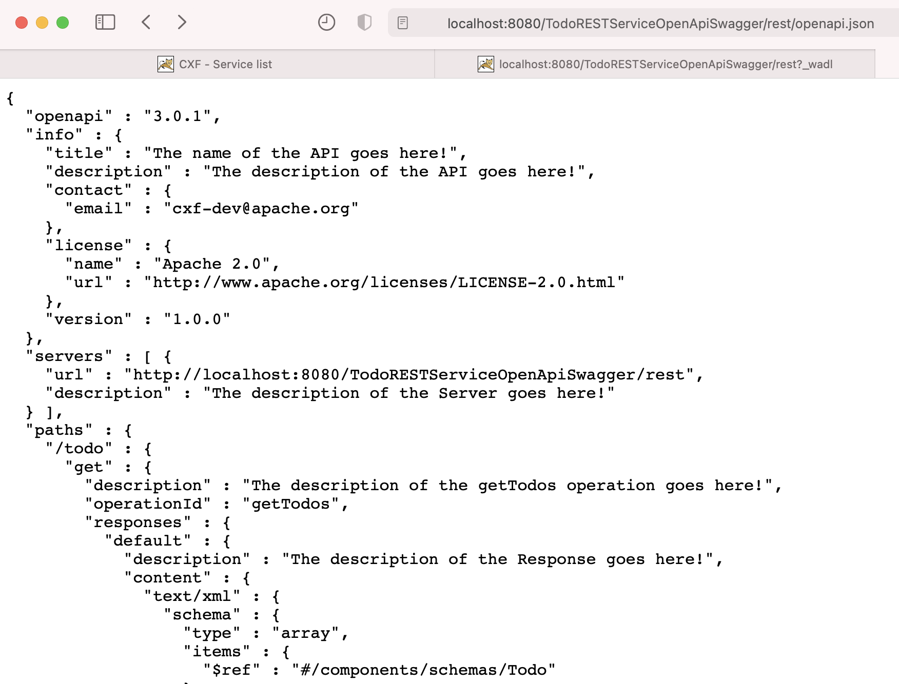
The REST API description - JSON
1

Slide 28
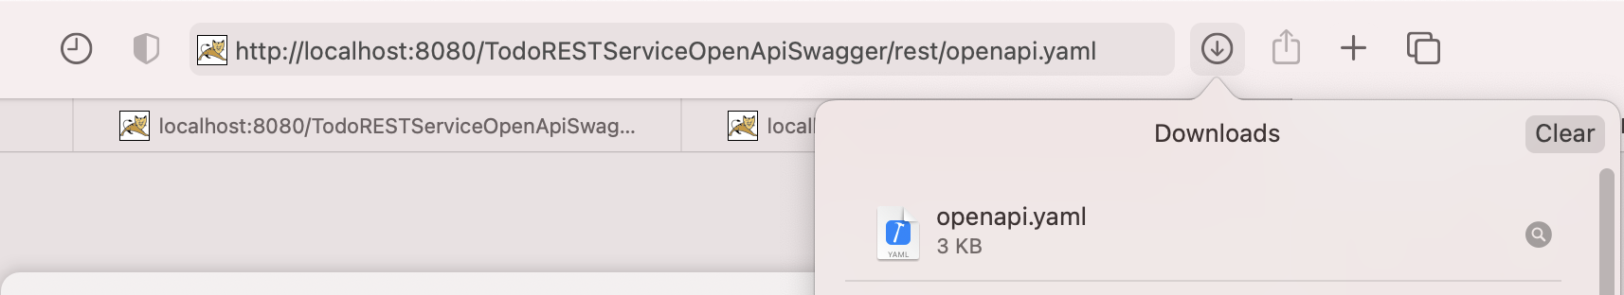
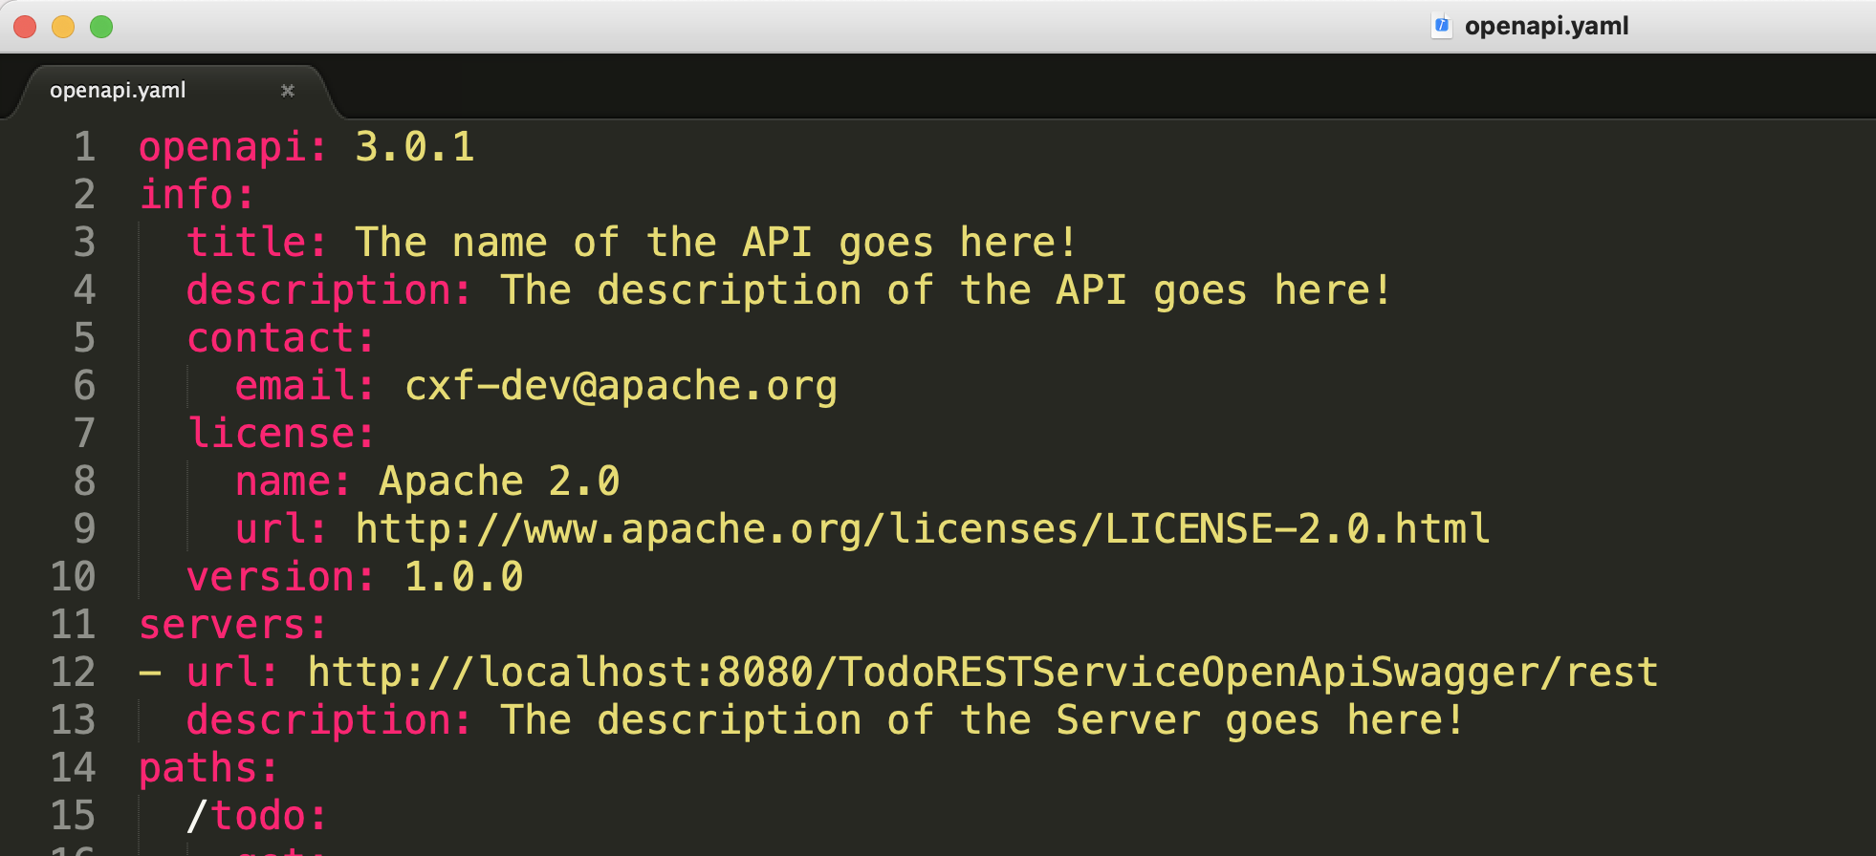
The REST Api description - YAML
1
2
2

Slide 29
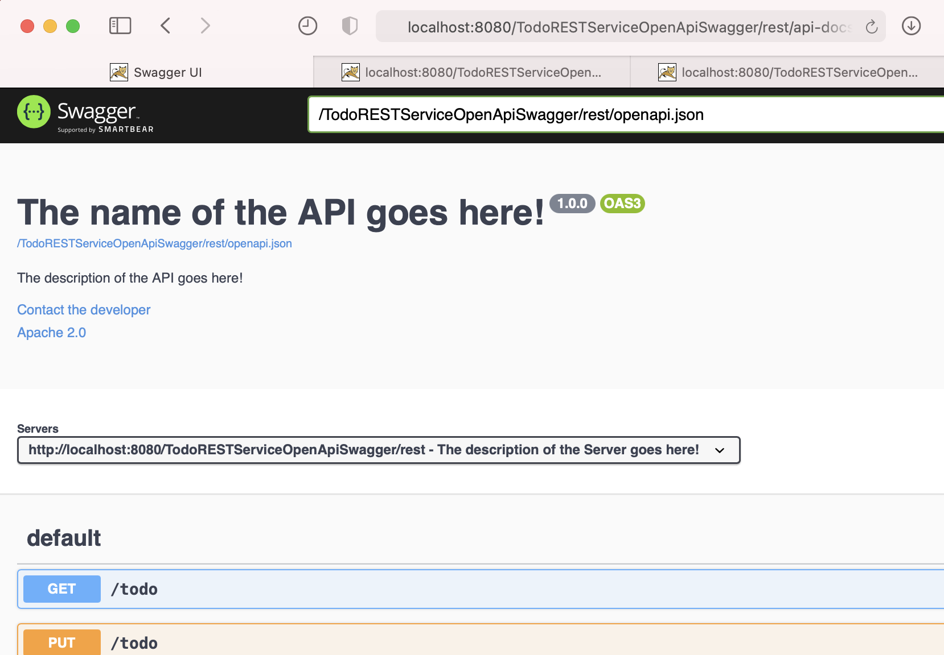
Swagger api-docs
1
2
point to .yaml or .json url
3

Slide 30
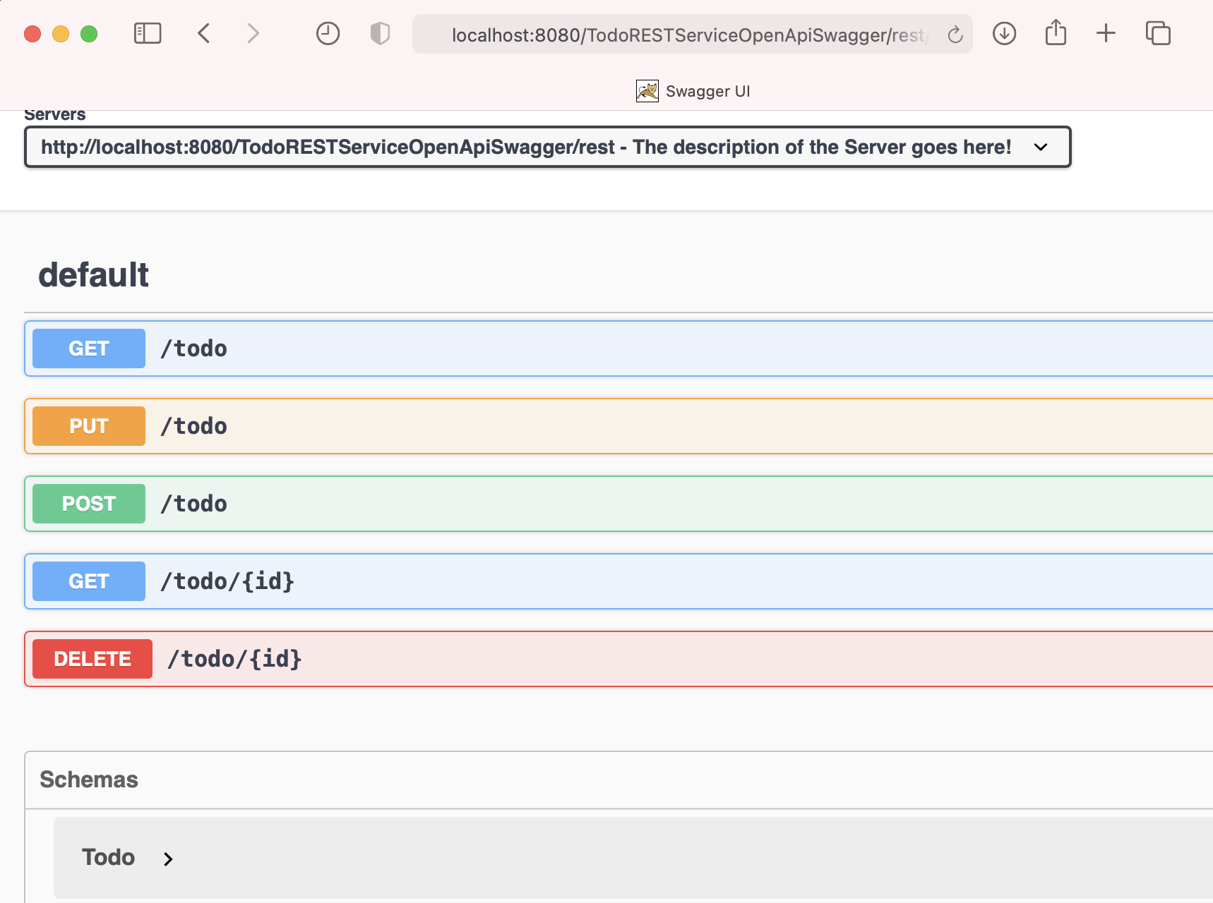
Swagger api-docs
List<Todo> getTodos()
boolean update(Todo todo)
boolean create(Todo todo)
Todo getTodo(String id)
boolean delete(String id)

Slide 31
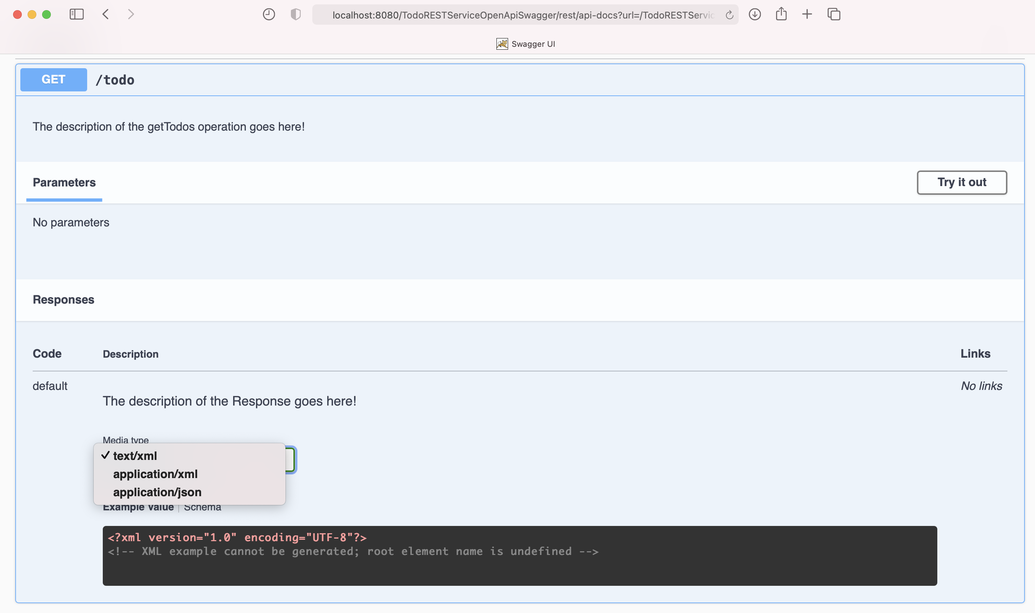
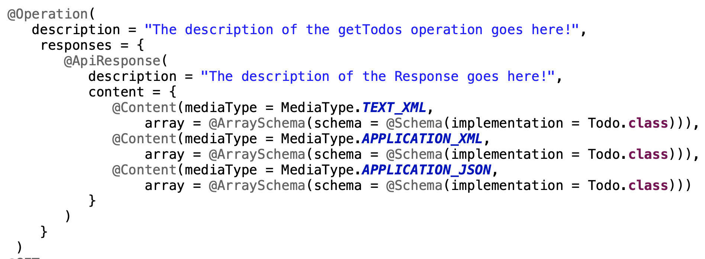
Try to invoke GET /todo
List<Todo> getTodos()
1
2
3

Slide 32
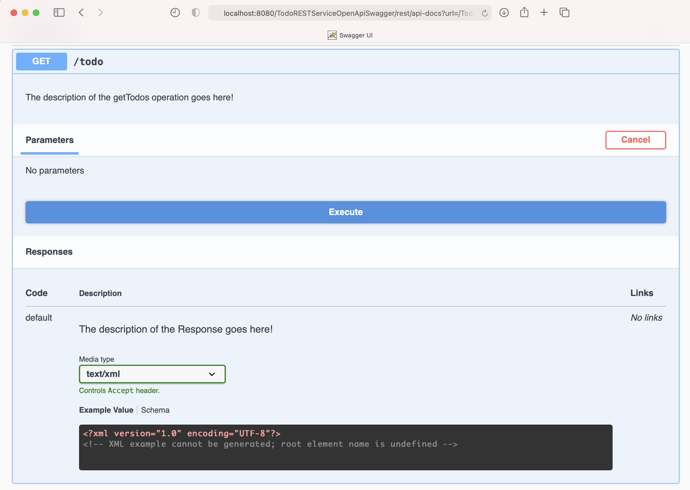
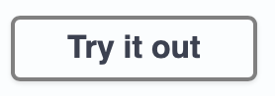
Try to invoke GET /todo
1
2

Slide 33
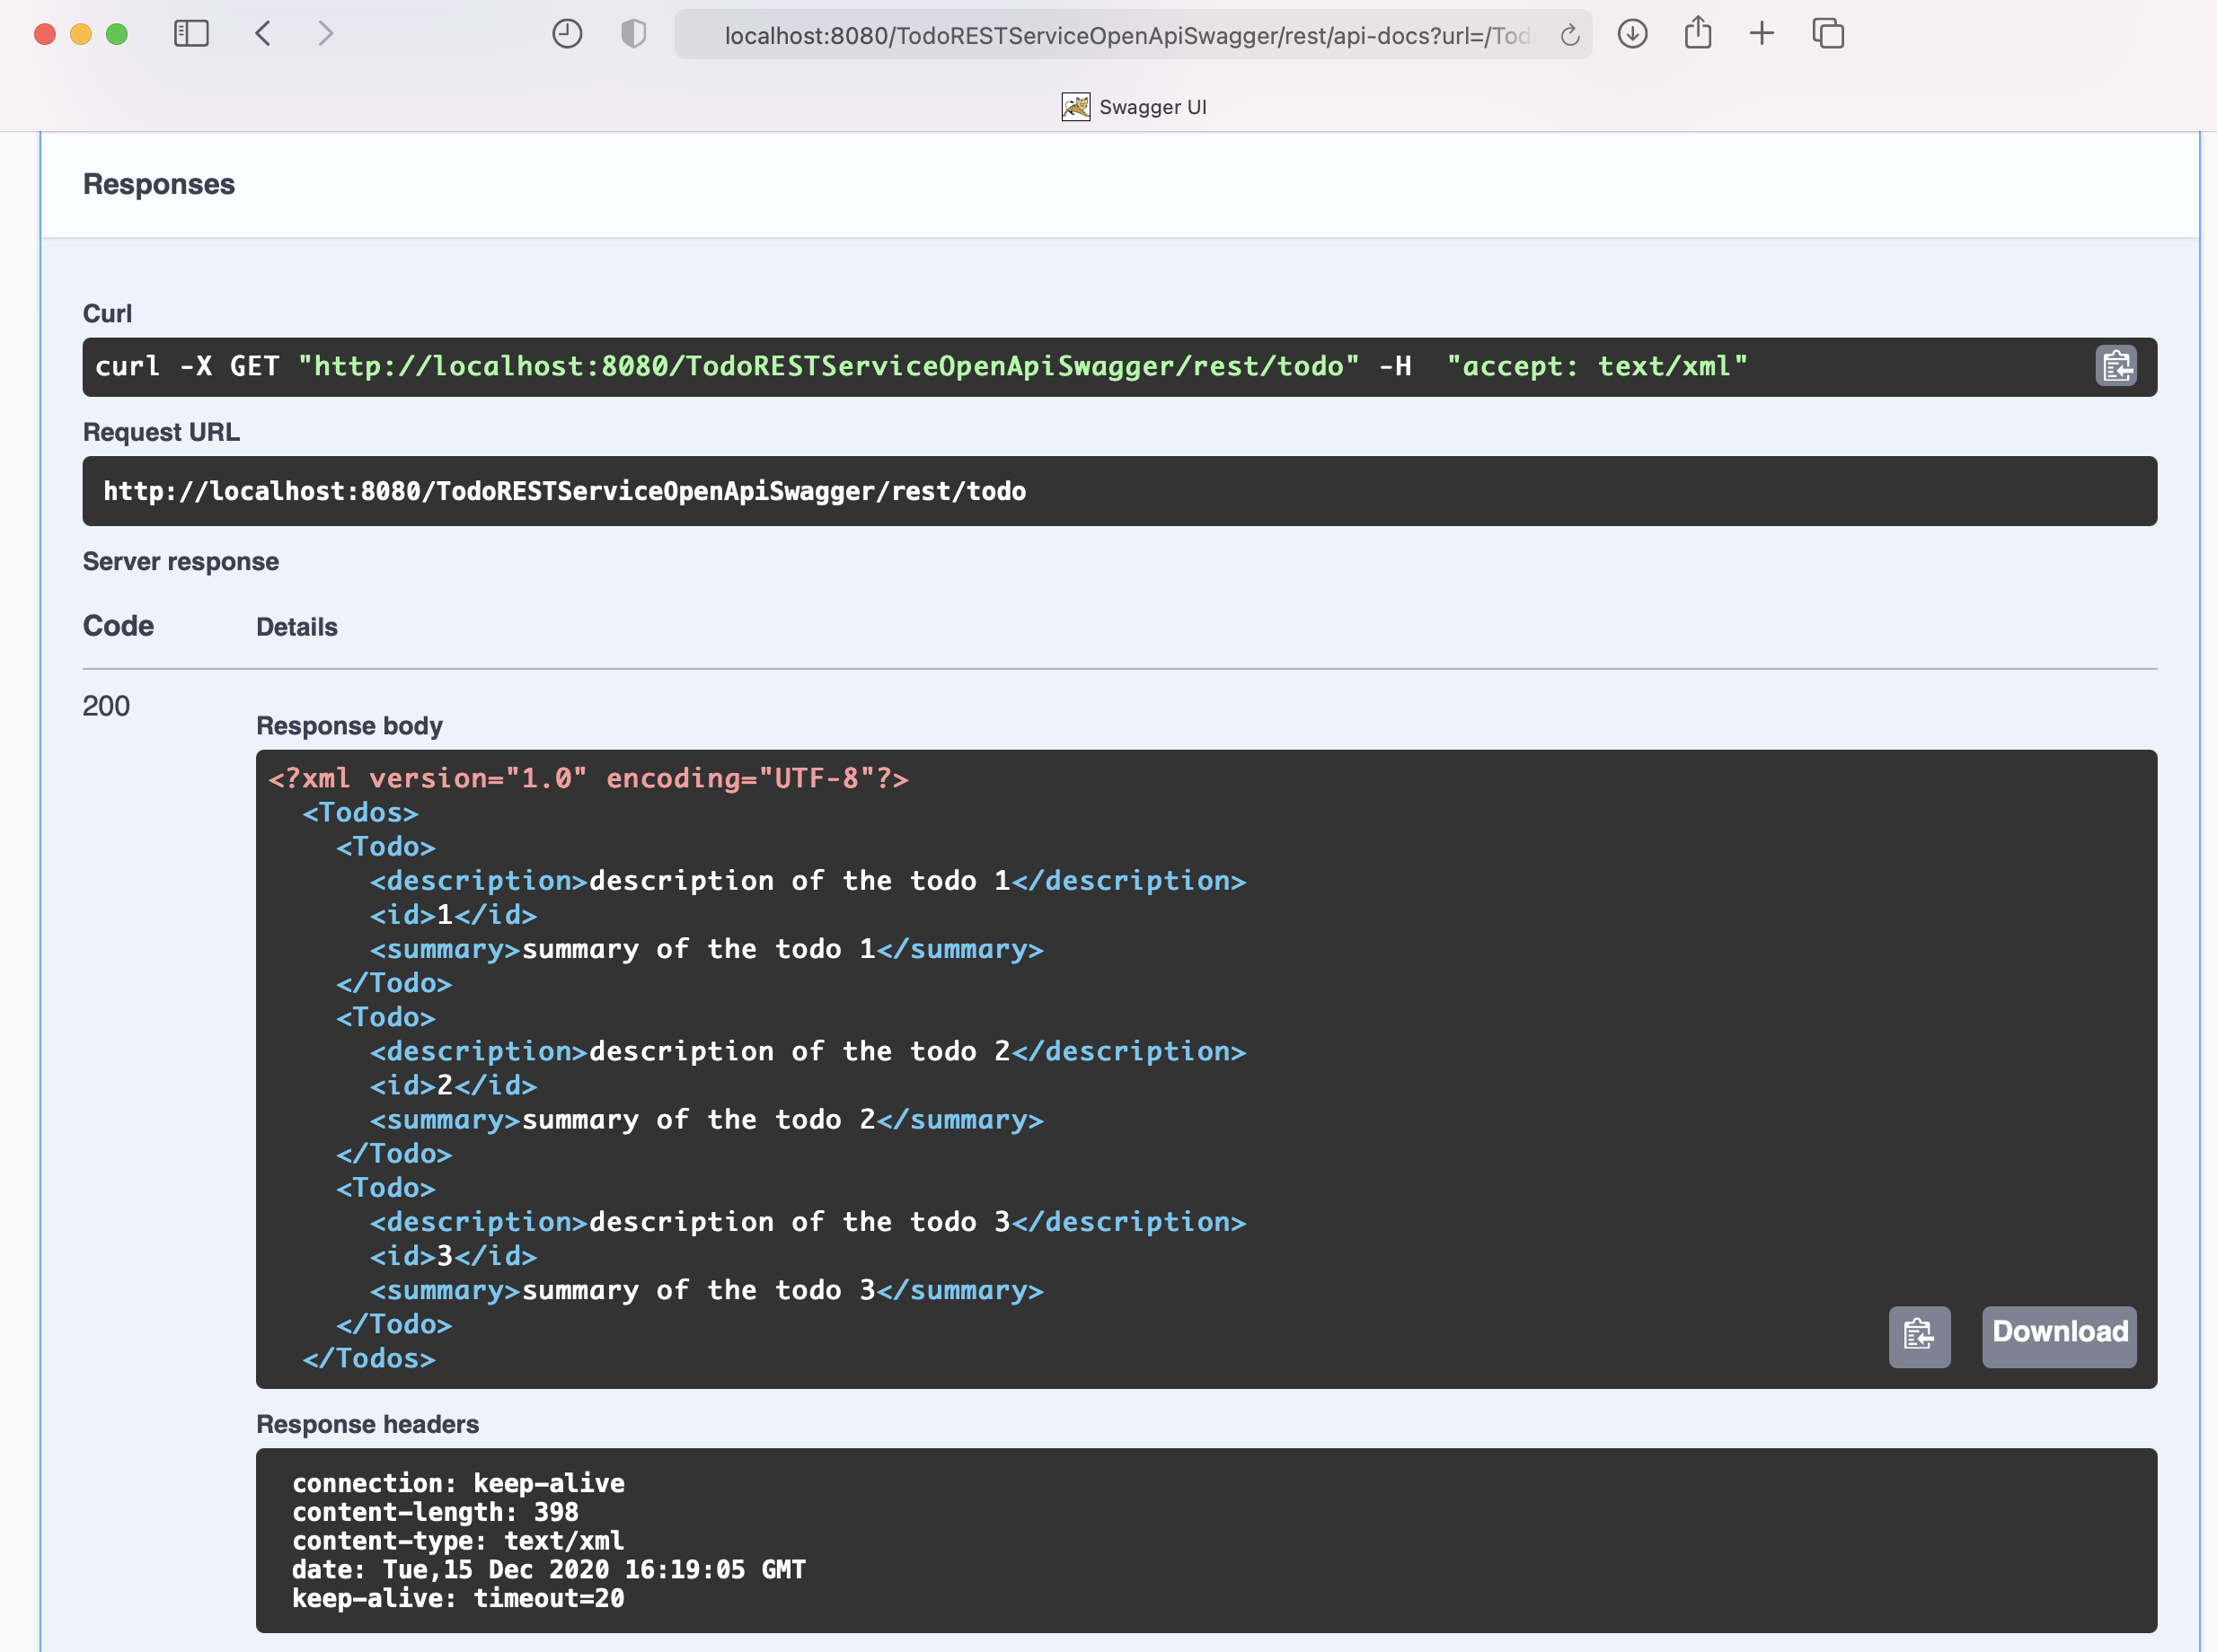
Try to invoke GET /todo
1
2
XML response body

Slide 34
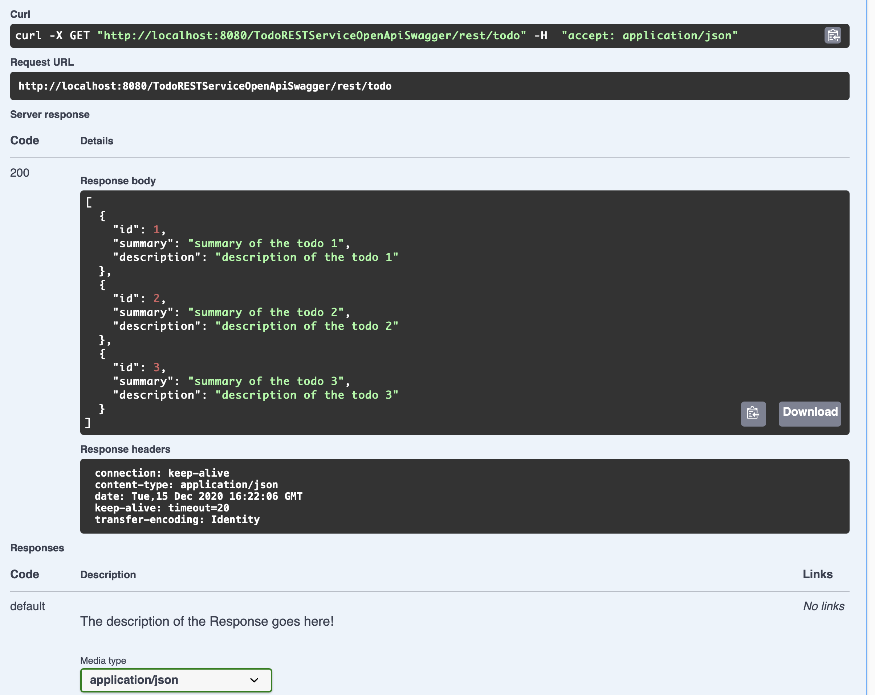
Try to invoke GET /todo
1
2
JSON response body
1

Slide 35
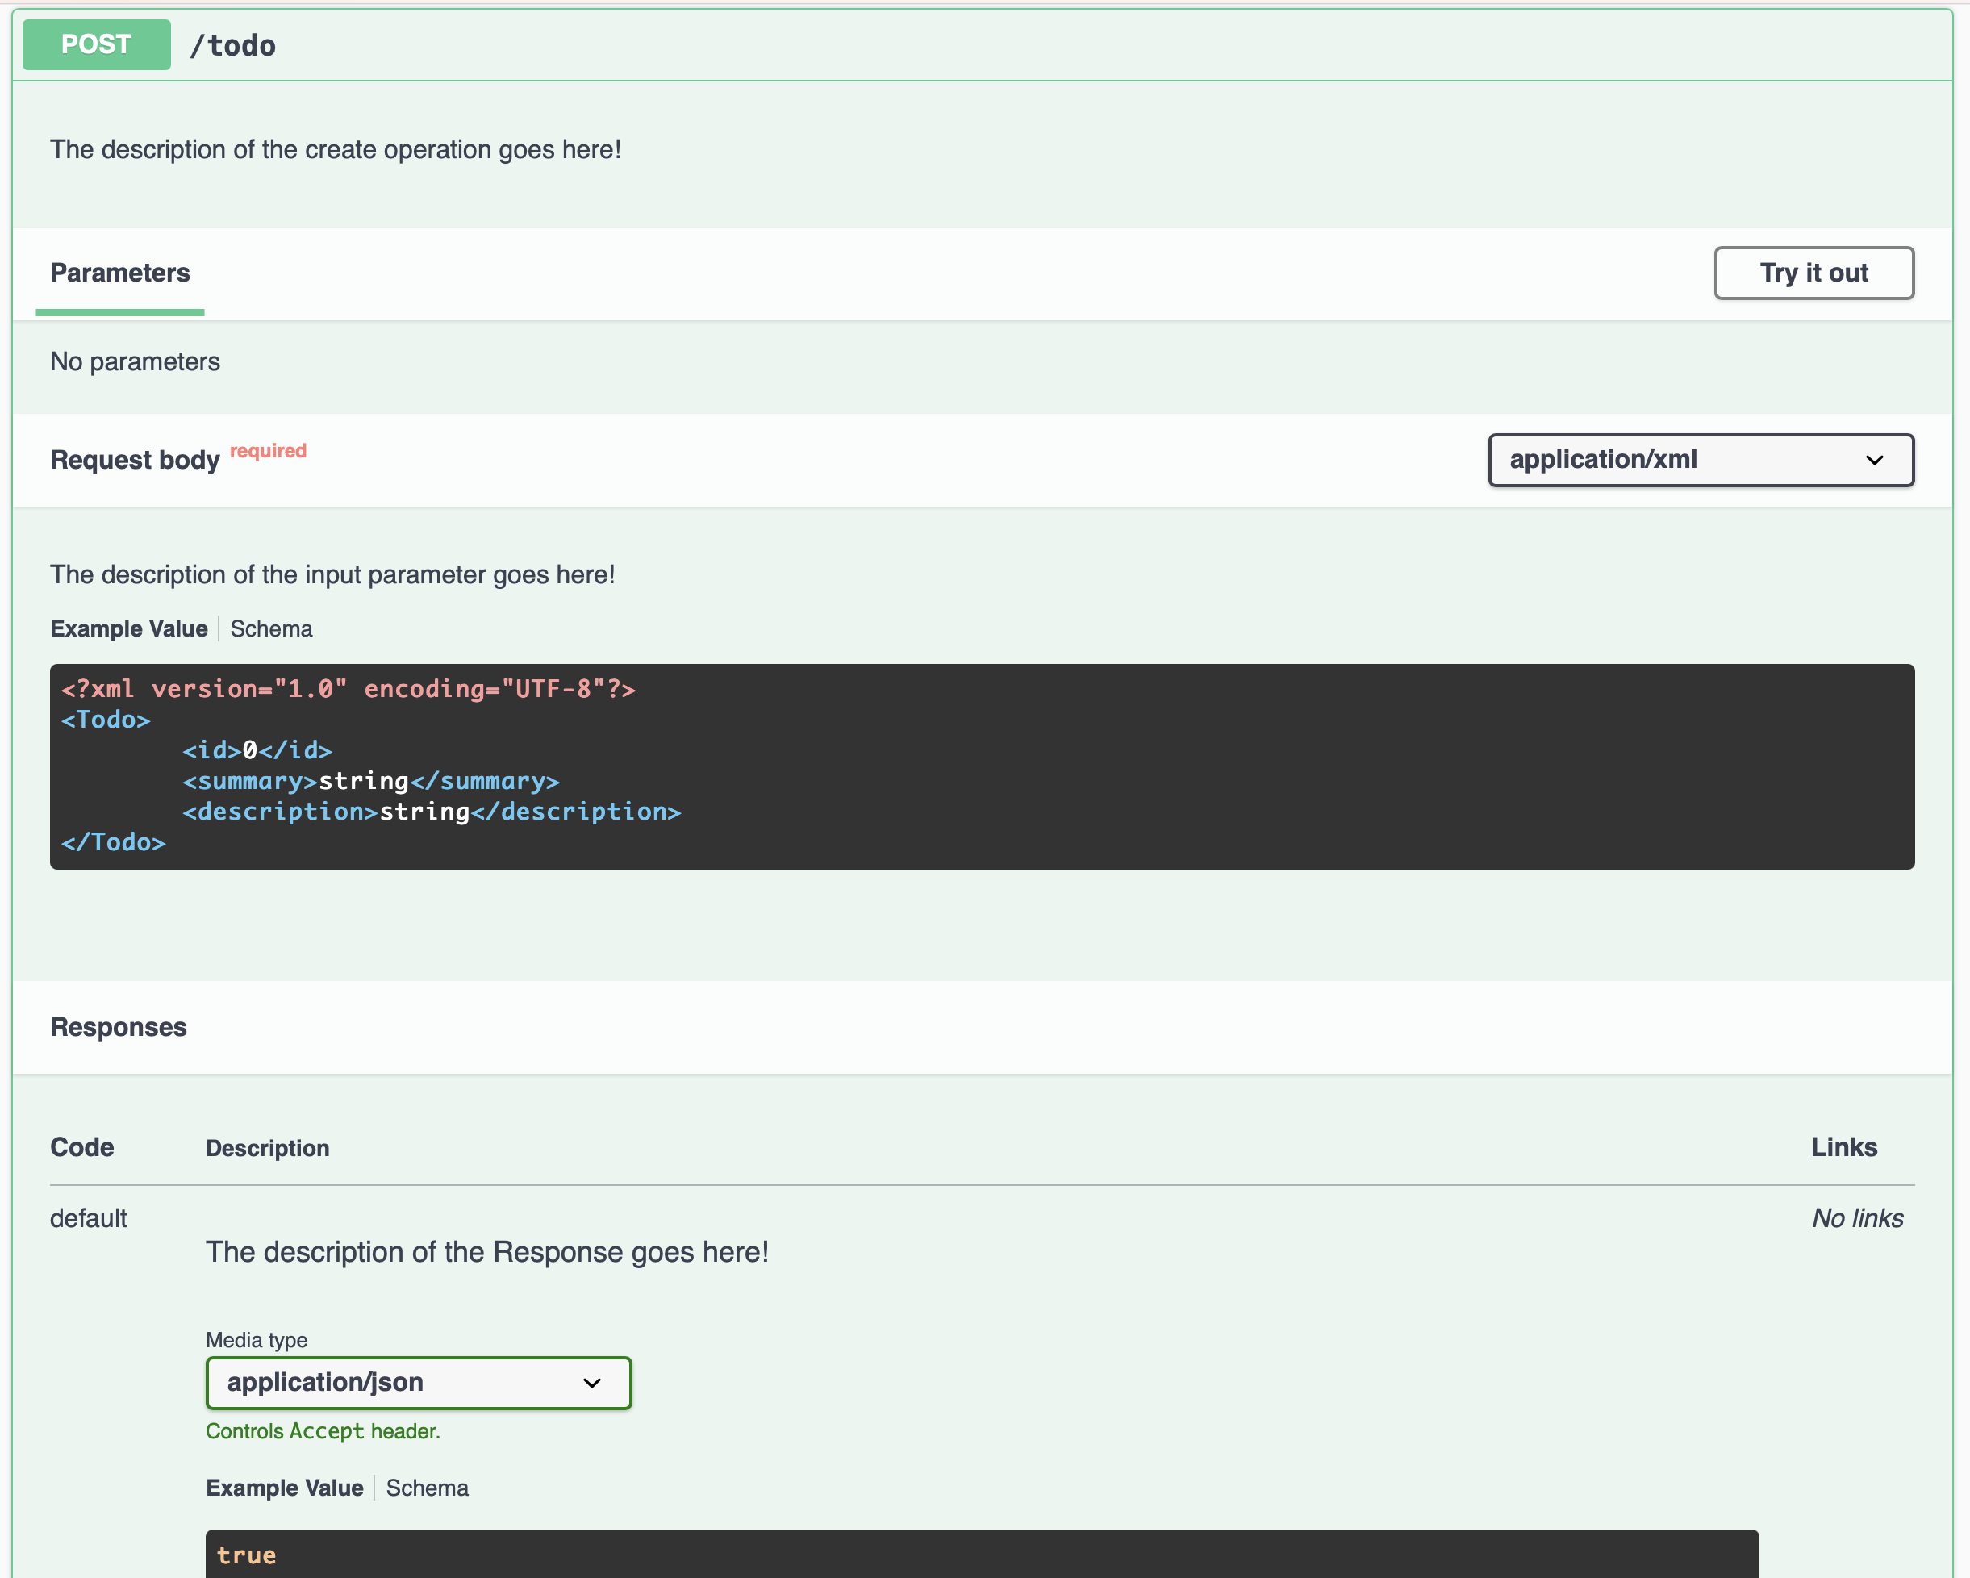
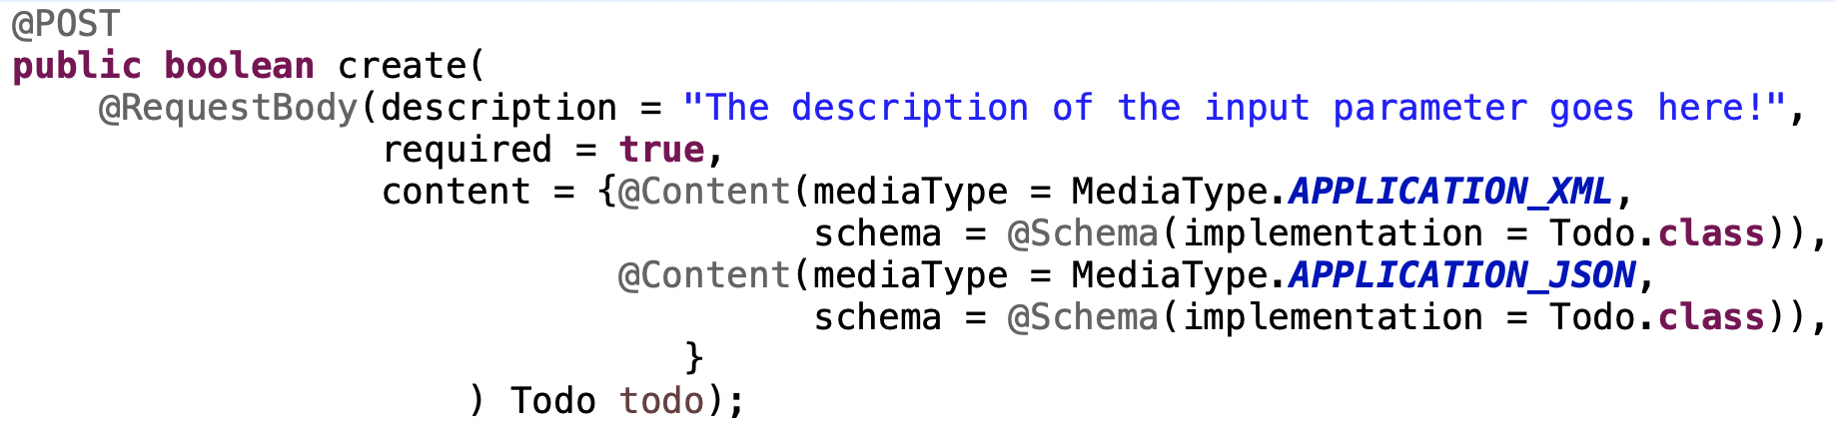
Try to invoke POST /todo
boolean create(Todo todo)
2
1
3

Slide 36
Try to invoke POST /todo
XML request body
1
2
3

Slide 37
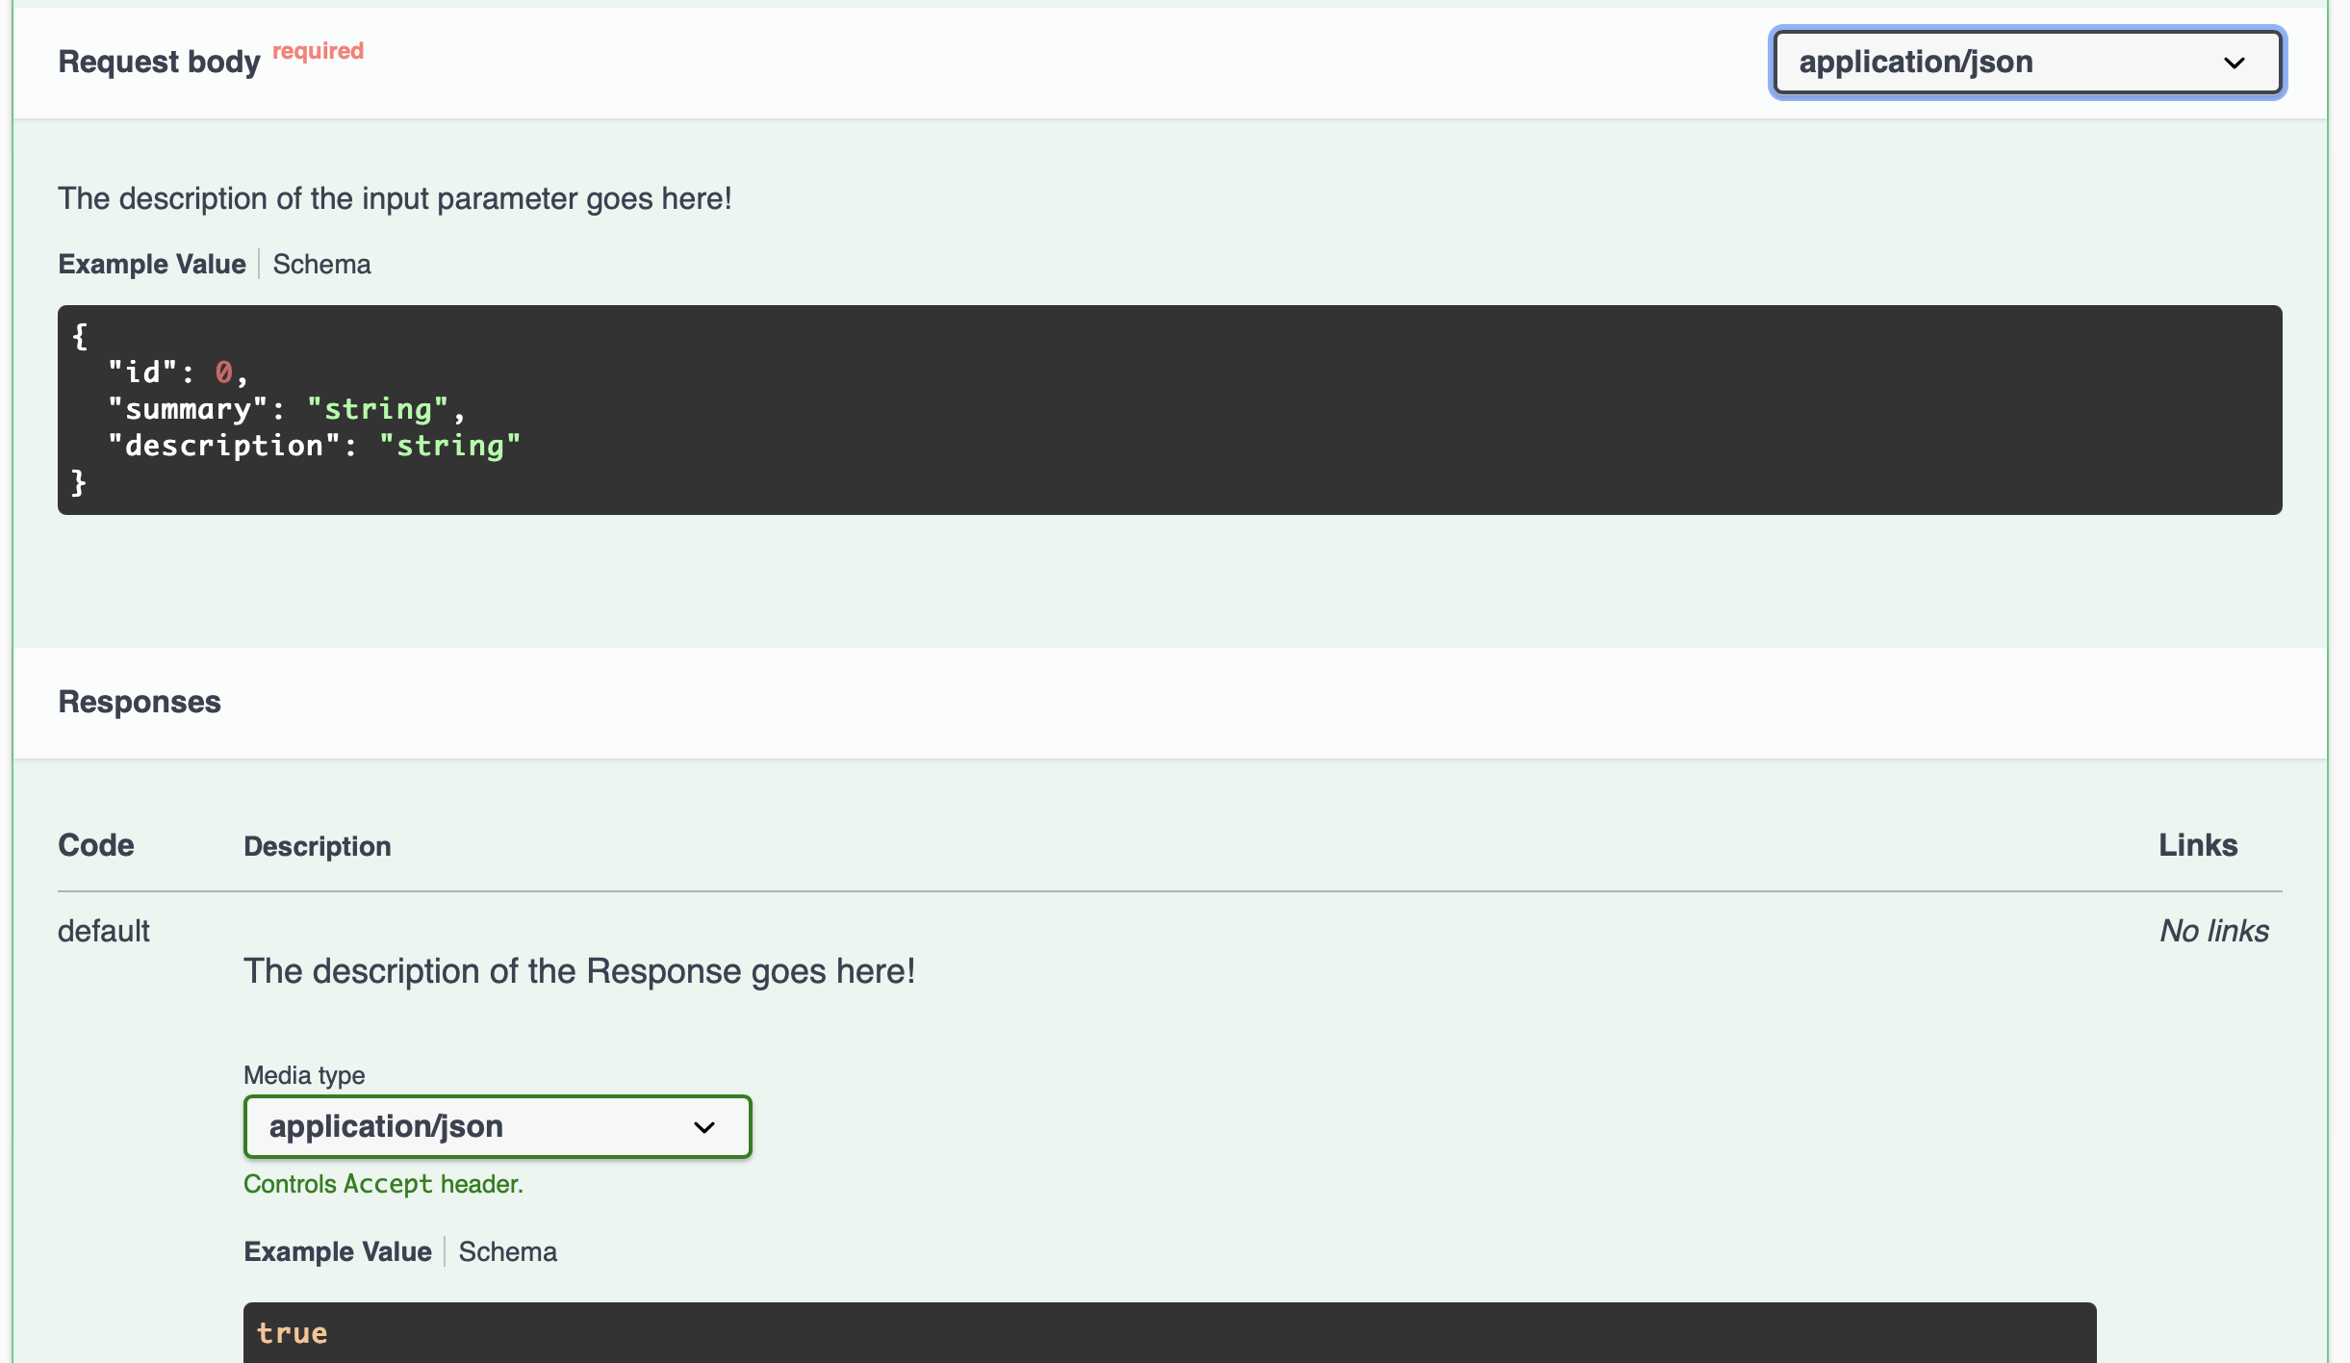
Try to invoke POST /todo
1
2
JSON request body

Slide 38
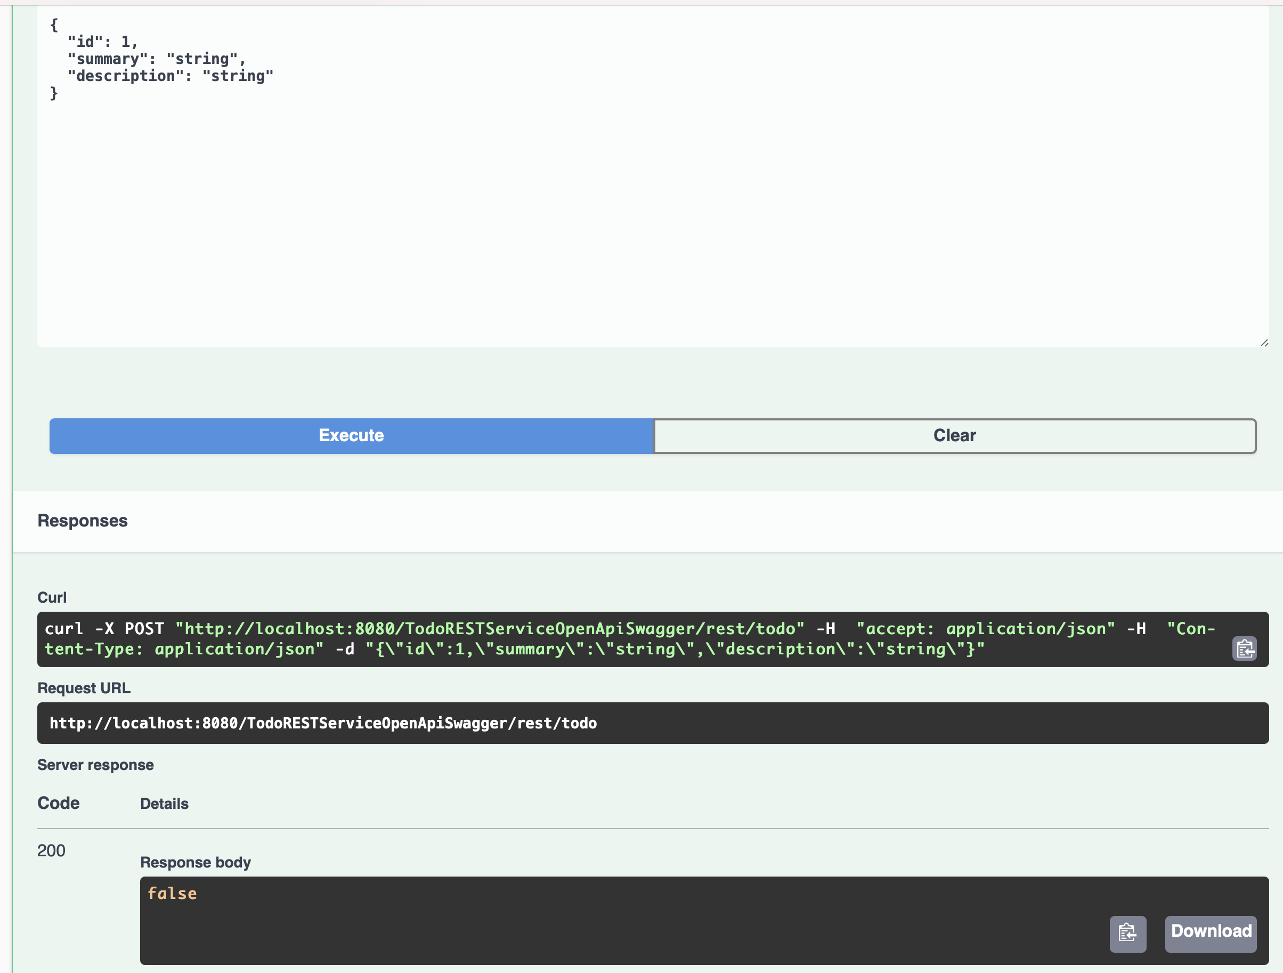
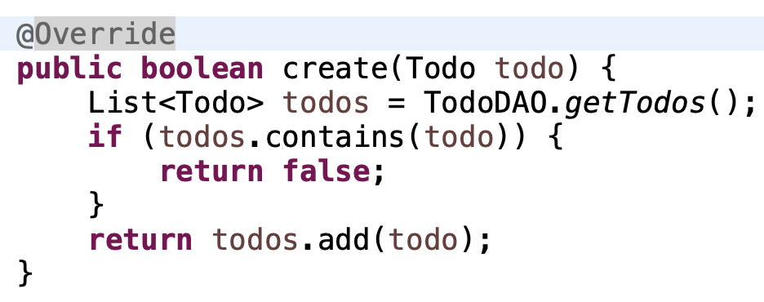
Try to invoke POST /todo
1

Slide 39

Try to invoke POST /todo
1

Slide 40
Generate a “jaxrs-cxf-client”
for our REST service

Slide 41
Save the JSON or YAML Description
1

Slide 42
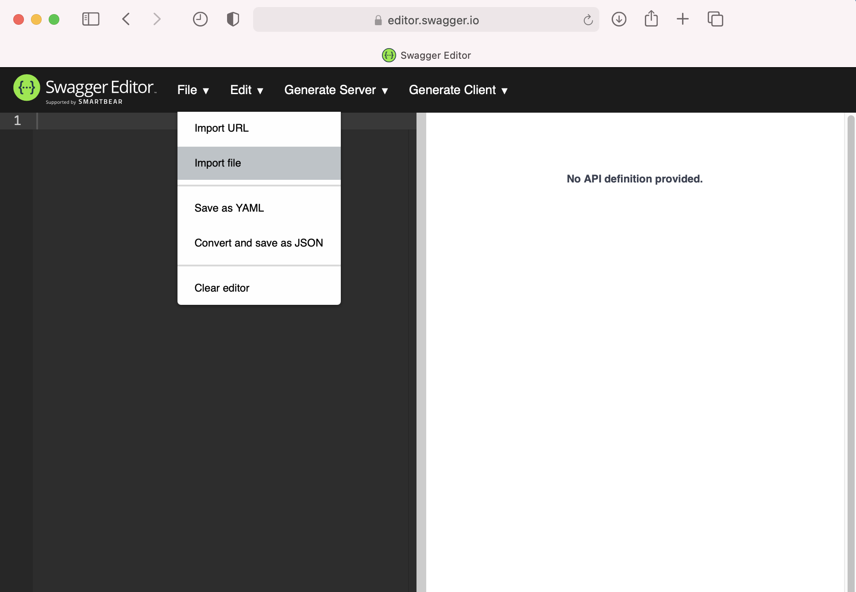
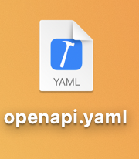
Import the JSON or YAML Description
1
2
1
I opted for importing the openapi.yaml file

Slide 43
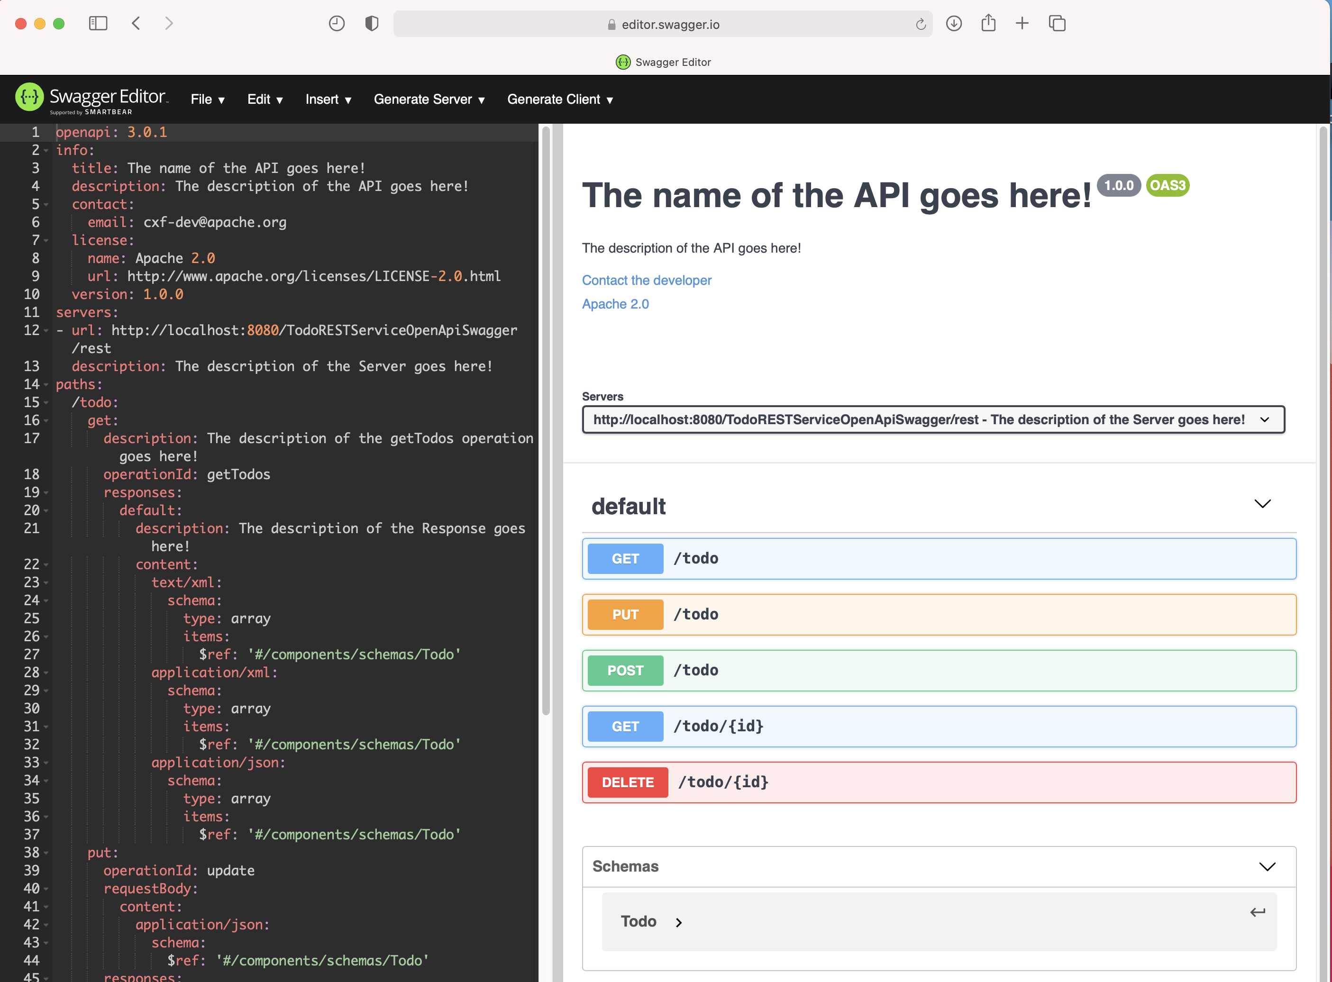
Import the JSON or YAML Description
1

Slide 44
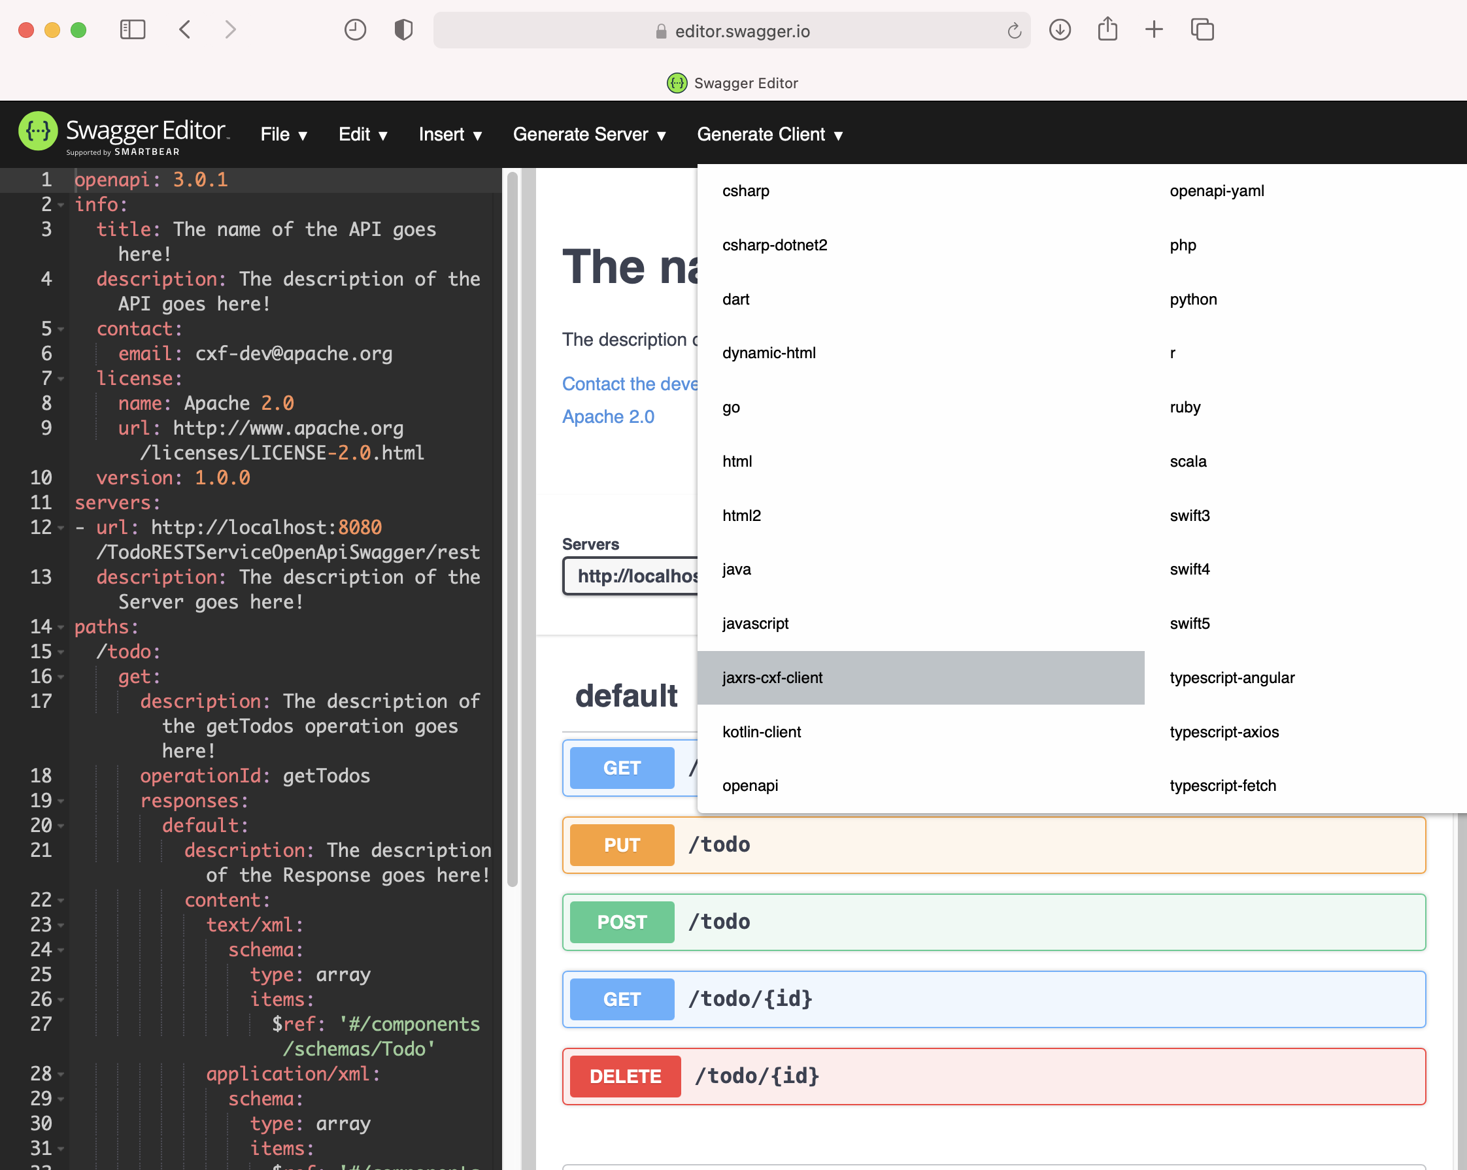
Generate the jaxrs-cxf-client Project
1
2

Slide 45
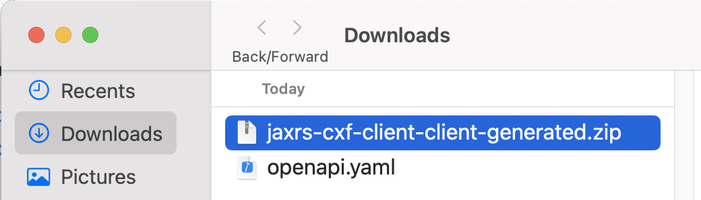
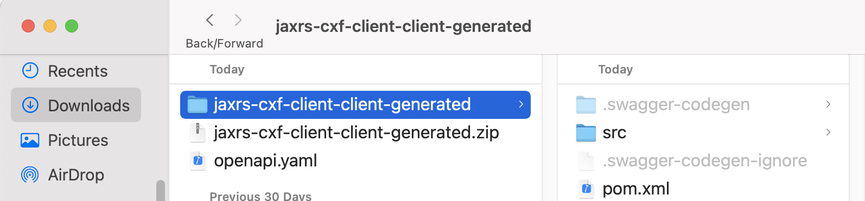
Generate the jaxrs-cxf-client Project
1
2
You get a mavenized project... That’s simply great ☺

Slide 46
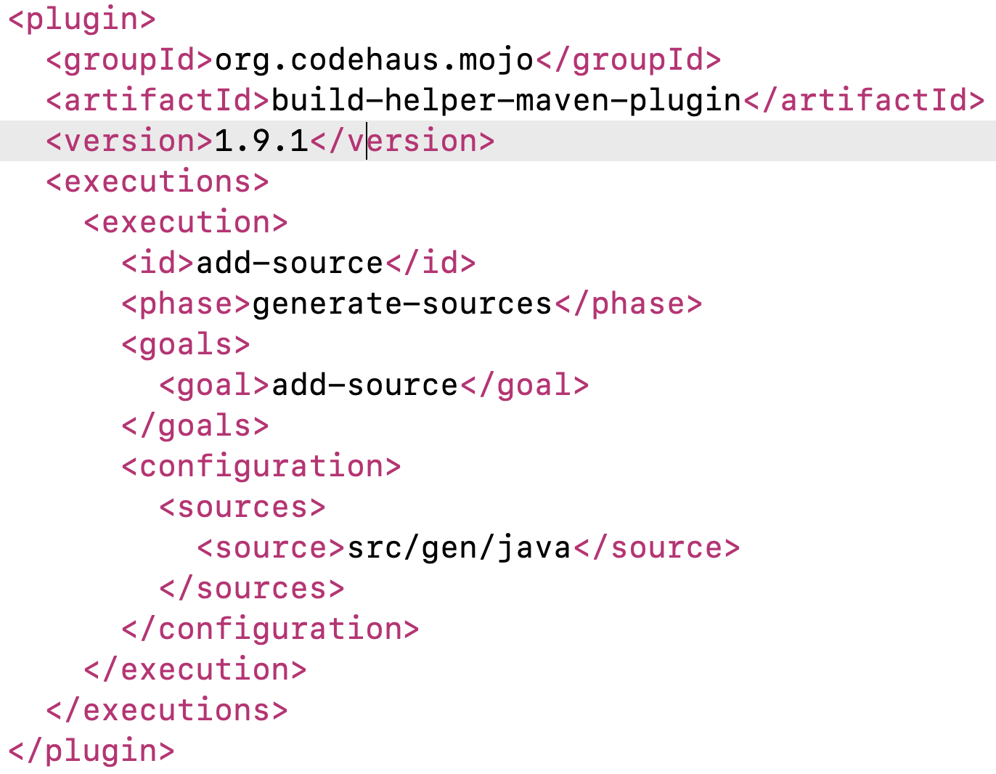
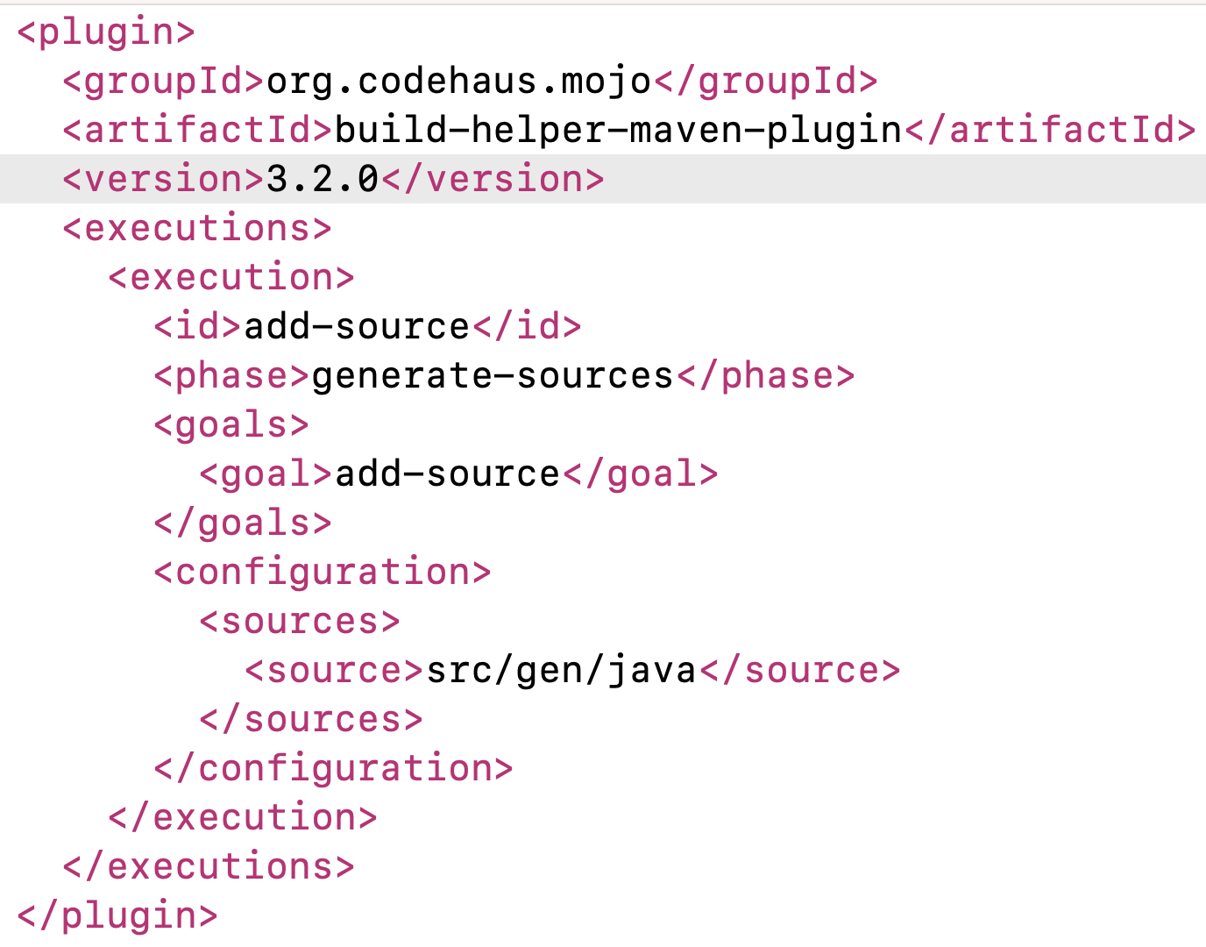
Fix the pom.xml
Fix the version

Slide 47
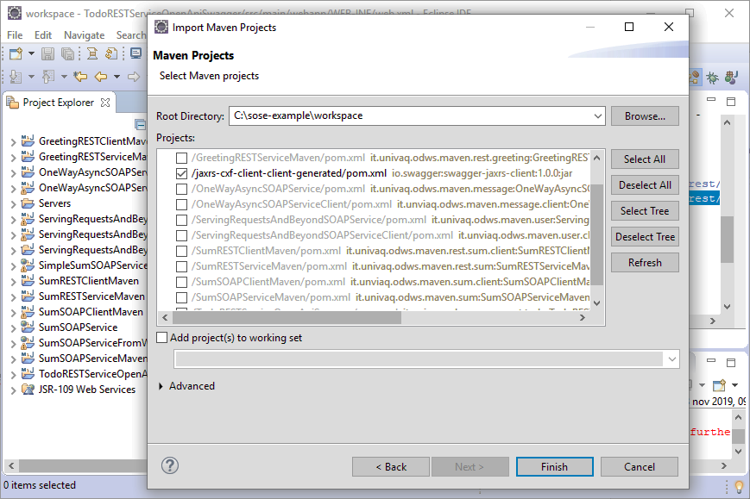
Import the jaxrs-cxf-client Project
1

Slide 48

Check the Generated Classes
1
2

Slide 49

Check the Generated Classes
Since it is a “create” operation, the code 201 would be more appropriate
1
2
https://restfulapi.net/http-status-codes/

Slide 50

Fix the Todo Class
1
@javax.xml.bind.annotation.XmlRootElement
Maps a class or an enum type to an XML element

Slide 51

Check the DefaultApiTest Class
1

Slide 52

Implement the createTest
1
2
3
4
5

Slide 53

Implement the deleteTest
1
2
3
4
5

Slide 54

Implement the getTodoTest
1
2
3
4

Slide 55

Implement the getTodosTest
1
2
3

Slide 56

Implement the updateTest
1
2
3

Slide 57

Execute Tests
Do not forget to run the “TodoRESTServiceOpenApiSwagger” service first ☺
2
3
1

Slide 58

Check Tests Execution
1
2

Slide 59

Generating the REST Client
That’s the method we have used so far for generating the REST Client
https://fizzylogic.nl/2018/09/26/learn-how-to-quickly-generate-rest-clients-from-swagger-files/

Slide 60

Alternative Way for Generating the REST Client (1/3)

Slide 61

Alternative Way for Generating the REST Client (2/3)
Three arguments → next slide

Slide 62

Alternative Way for Generating the REST Client (3/3)

Slide 63
References
http://cxf.apache.org/docs/openapifeature.html
https://swagger.io/docs/specification/about/
https://swagger.io/
https://voicebase.readthedocs.io/en/v3/how-to-guides/swagger-codegen.html#download-swagger-codegen-cli-tool
https://fizzylogic.nl/2018/09/26/learn-how-to-quickly-generate-rest-clients-from-swagger-files/

